Slide 1


Year 6

Slide 2
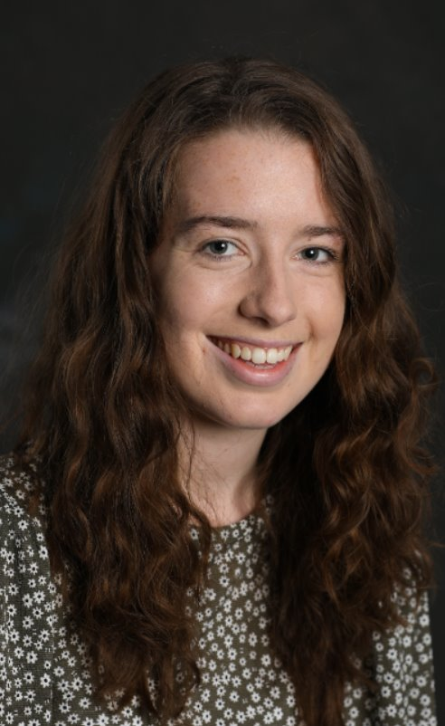
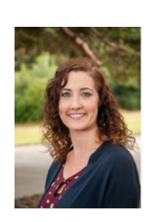
The Year 6 Team:
Class teachers:
6LH
6EB
Miss Holland
Miss Bowles

Slide 3
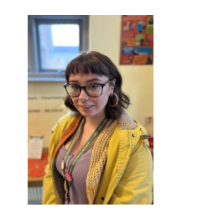
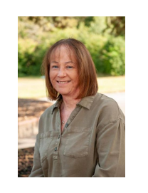
The Year 6 Team:
Teaching Assistants:
Miss Biles
Mrs Symonds

Slide 4


Vision and Values:

Slide 5

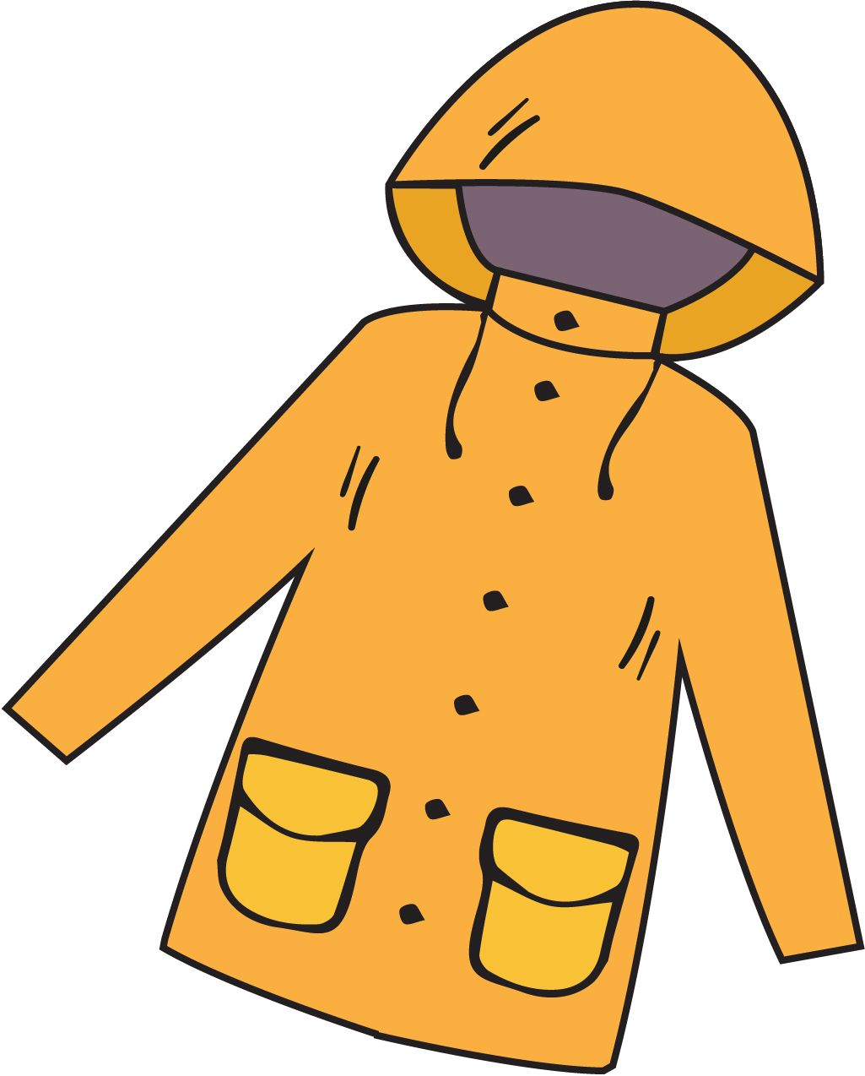

What does my child need to bring?
All stationery your child requires will be provided by the school
School planner
Reading book from home (optional)
Water bottle
Morning snack (fruit/veg)
Waterproof coat
Trainers (for break / lunchtime football)
*Please ensure all items are named – thank you!

Slide 6
School uniform:
Yellow polo shirt with school logo and grey V-neck jumper or cardigan.
Black trousers or shorts / black knee-length skirt or pinafore / yellow & white checked summer dress.
Black socks (ankle or knee length) or black tights.
White socks with summer dresses only please.
Black formal leather or leather-look school shoes.
All hair at or below shoulder length must be tied back at all times.
Hair should be off the face, clipped back and not obscuring sight.
Hair ties should be in appropriate colours and styles suitable to blend with school uniform (yellow/white bands).

Slide 7
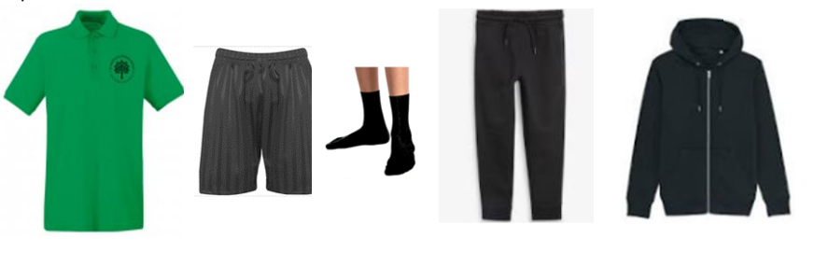

P.E Kit:
Emerald green short-sleeved polo shirt with logo
Plain black shorts
Short black socks
Plain black tracksuit for winter
Trainers only to be worn on P.E. days, but should be in school for break/lunchtime football.
Earrings must be removed & hair tied back and off the face
No gym/cycling shorts or leggings please

Slide 8
St Mark’s School Planner
Walking Home Permission- signed agreement in planner, followed with a single e-mail.
Home school Child Agreement- signed my parent/carer and child.
E-Safety Pupil Agreement- signed by child
Spellings record
Reading record

Slide 9
Mobile phones
Only children who walk to or from school independently are allowed to bring phones into school.
Children will need to drop their phone at the office on arrival and collect it at the end of the day.
No phone usage is allowed anywhere on site during the school day.

Slide 10
How is the week structured?
English (including reading, writing, grammar, spelling & handwriting) and Maths are taught daily
Weekly timetable includes P.E, R.E, Science, Music, French & PSHE (following a new scheme, “Kapow”).
Geography, History, Computing, Art & Design and Design Technology will be taught in units throughout the year
As each subject area is taught discretely, children are taught to appreciate the distinctive uniqueness of individual subjects and aspire to become future scientists, computer coders, historians, etc.
The Year 6 curriculum map can be found on the school website.

Slide 11

Curriculum:
English: Although we are no longer using the Literary Curriculum to deliver our English lessons, they will still be taught through the use of high-quality texts through most of the year. This serves as a basis to develop the children’s writing and appreciation of spelling, punctuation and grammar.
Children will be given the opportunity to write for a range of contexts, purposes and audiences.

Slide 12



A selection of our Year 6 class texts:

Slide 13



Curriculum:
Maths:
We will continue to use the White Rose scheme of learning to deliver high-quality mathematics lessons with a focus on developing the children’s mathematical fluency, as well as their ability to problem solve and apply their learning to different real-life contexts.

Slide 14
Weekly Timetable:
Daily act of worship
P.E: twice a week
6LH: Tuesday and Thursday
6EB: Wednesday and Thursday
Spelling test on Monday / Arithmetic/times tables on a Friday

Slide 15
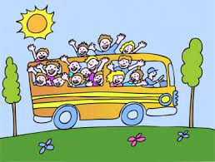
Educational Visits:
We enhance and enrich the curriculum through a variety of activities: educational trips and visitors, school performances, as well as extra-curricular lunchtime and after school clubs.
Important dates:
- Bovington Tank Museum
16th October 2026
- Year 6 Residential to Brenscombe:
7th – 9th June 2027

Slide 16

Residential:
Brenscombe Outdoor Centre, Swanage :
7th – 9th June 2027
Three-day, two-night visit
The trip is an action-packed three days participating in a range of enjoyable activities, including water sports and evening entertainment
The trip will be an excellent opportunity for team-work, promoting independence, confidence building, tackling new experiences and so much more. We very much hope that your child will be able to join us on this visit.

Slide 17

Feedback:
Focus on verbal feedback
Dialogue with your child, focusing on their next steps
Use of feedback code in books

Slide 18
KS2 SATs
Week commencing: Monday 10th May 2027
End of Key Stage 2 SATs take place during the summer term.
They are used to show your child's progress compared with other children across the country.
The assessments cover Maths (arithmetic and reasoning), reading, as well as spelling, punctuation and grammar. The papers will be sent away to be marked.
English Writing will be assessed through moderated Teacher Assessment only.
In July, you will receive a report showing the Teacher Assessment (the level the teacher thinks your child is working at) and the SATs results.
We will deliver a separate parent information meeting closer to the time of the assessments.

Slide 19

The KS2 SATs – how to support:
Support your child throughout the year to develop their confidence in reading by practising reading aloud, making sure they take time to read quietly and ask them questions about their reading.
Make sure your child regularly practises their spellings and times tables to develop fluency.
Use the home learning materials to support in reinforcing what they have learnt in class.
Reassure them that they don’t need to worry and to try their best in their learning throughout the year.

Slide 20


Homework Expectations:
Weekly expectation: Workbook tasks/ daily reading / weekly practising of times tables and spellings
Each child will receive a CGP workbook for Maths, SPAG and Reading. They will have work set every Friday, to be completed by the following Thursday.
If children do not complete work, they may be asked to spend time completing their work during their lunchbreak in a catch-up session.

Slide 21



Reading - children are asked to read a wide variety of genres at least 4 times a week at home. Please sign their planner each week to acknowledge this.
Weekly spellings – focus on spelling patterns and common exception words. Words will be accessible to practise on Spelling Shed.
Times tables – practise quick recall of multiplication facts up to 12x12 and their corresponding division facts.

Slide 22

Year 6 Monitor jobs:
Range of responsibilities available:
Prefects
Team captains
Worship Council
Librarians
Trick Box Ambassadors
Sports Leaders

Slide 23
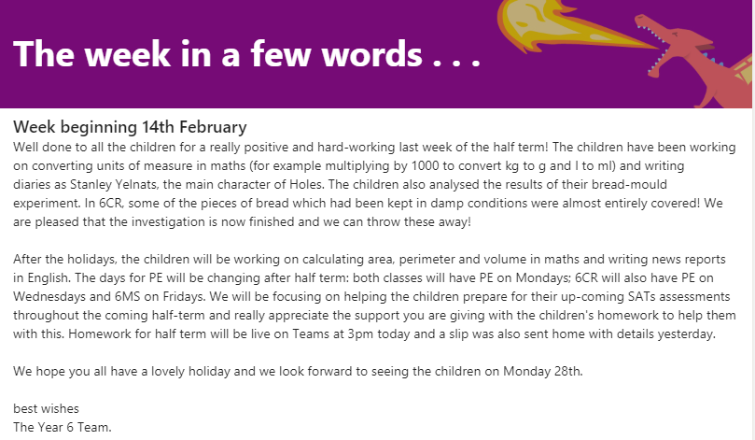
A week in a few words:
We will continue to post a weekly summary of your child’s learning on Microsoft TEAMS. We will also endeavour to inform you of what we will be covering during the following week.

Slide 24

Any questions? …
Thank you for listening.

