Slide 1


Year 4

Slide 2

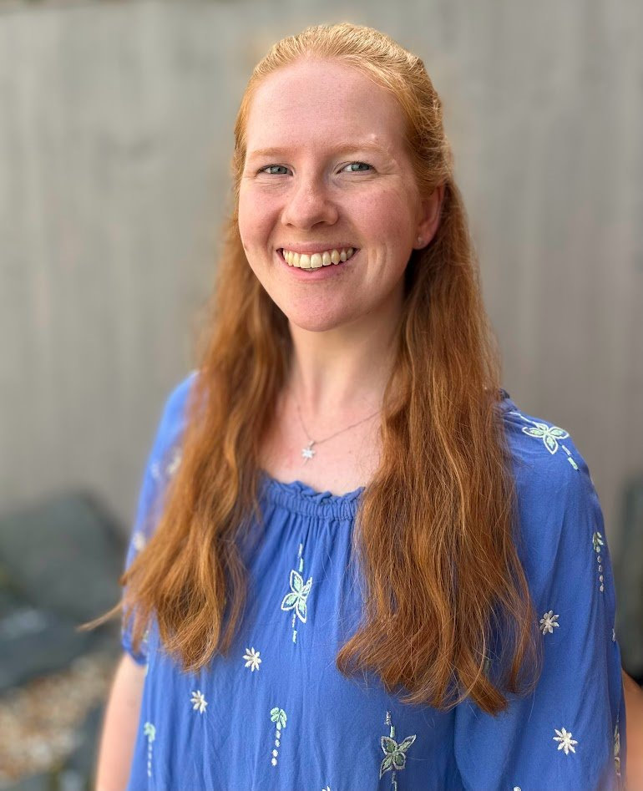
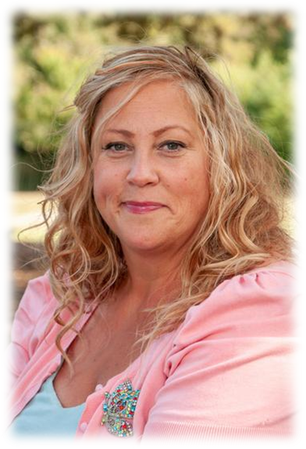
The Year 4 Team:
Class teachers:
4AS
4MS
Miss Smith
Mrs Scoble

Slide 3


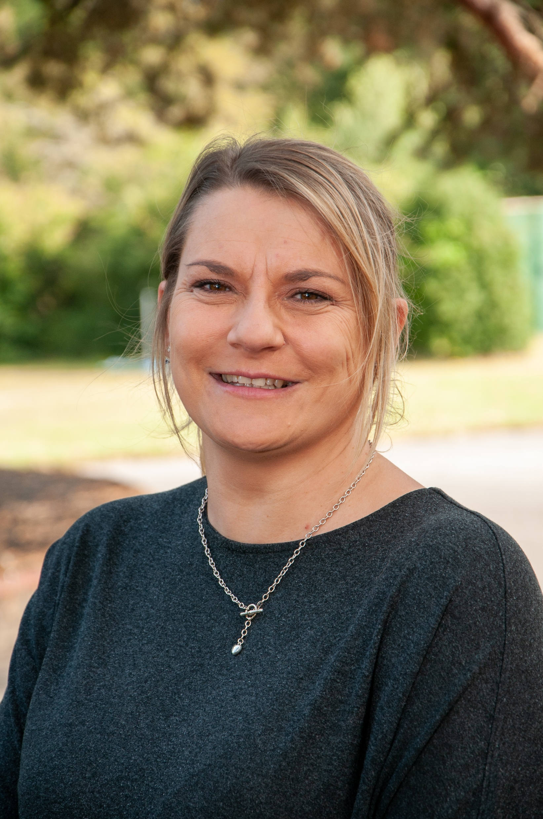
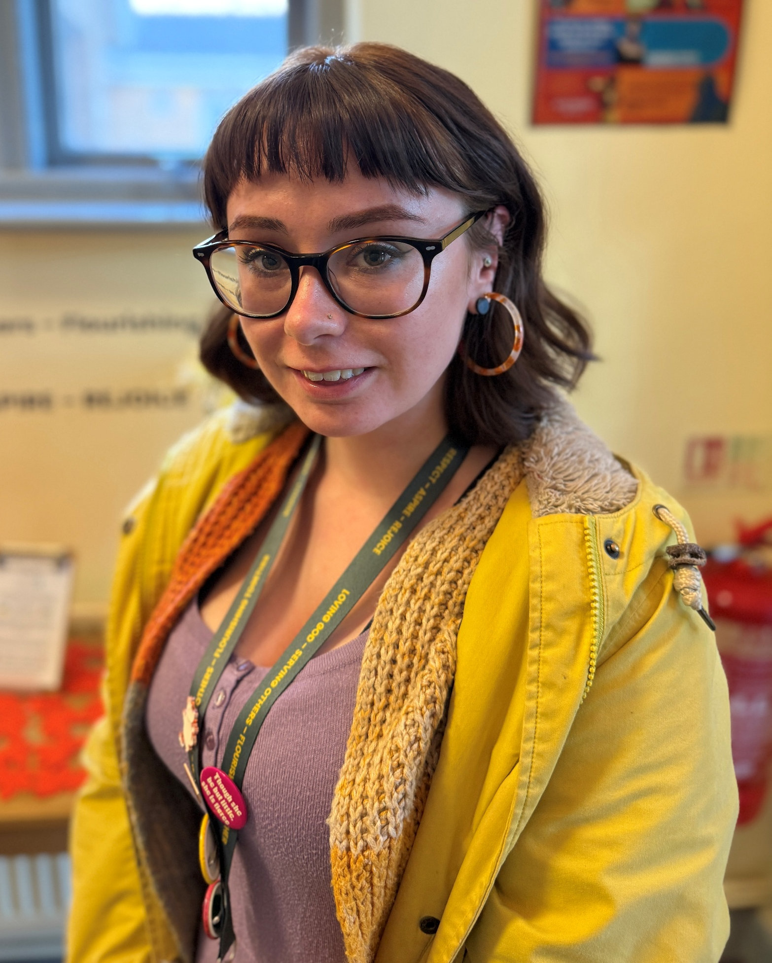
The Year 4 Team:
Teaching Assistants:
Mrs Sanchez- Martin
Mrs Cousins
Miss Biles

Slide 4


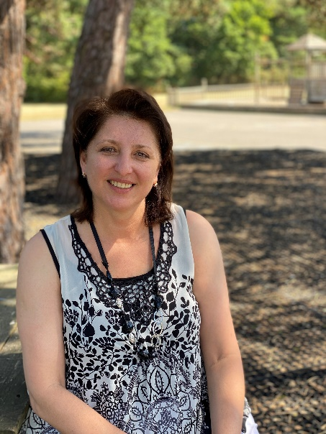
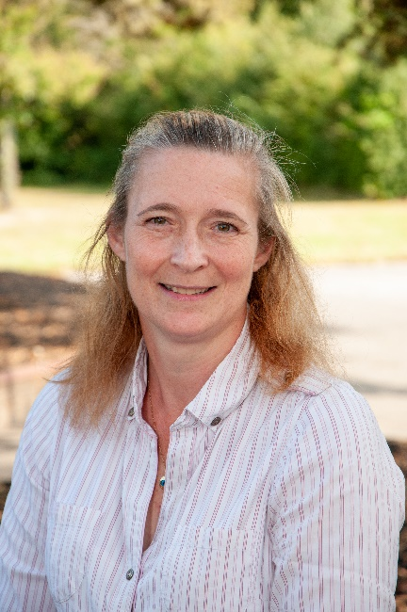
Year 4 PPA cover teachers:
Mrs Hemmings
Ms Trickett

Slide 5
Weekly Timetable:
Daily act of worship
P.E: twice a week
4AS: Wednesday outside, Monday inside
4MS: Wednesday outside, Friday inside.
Spelling test on Monday
Times table challenge on Friday mornings.
Multiplication check practise twice a week at school.

Slide 6
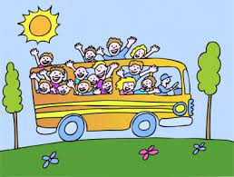
Educational Visits:
We enhance and enrich the curriculum through a variety of activities: educational trips and visitors, school performances, as well as extra-curricular lunchtime and after school clubs.
Important dates:
Autumn term - TBC
Spring term – TBC
Summer term –World War Two Bunker
Learning guitar in school with Soundstorm in the summer term.

Slide 7
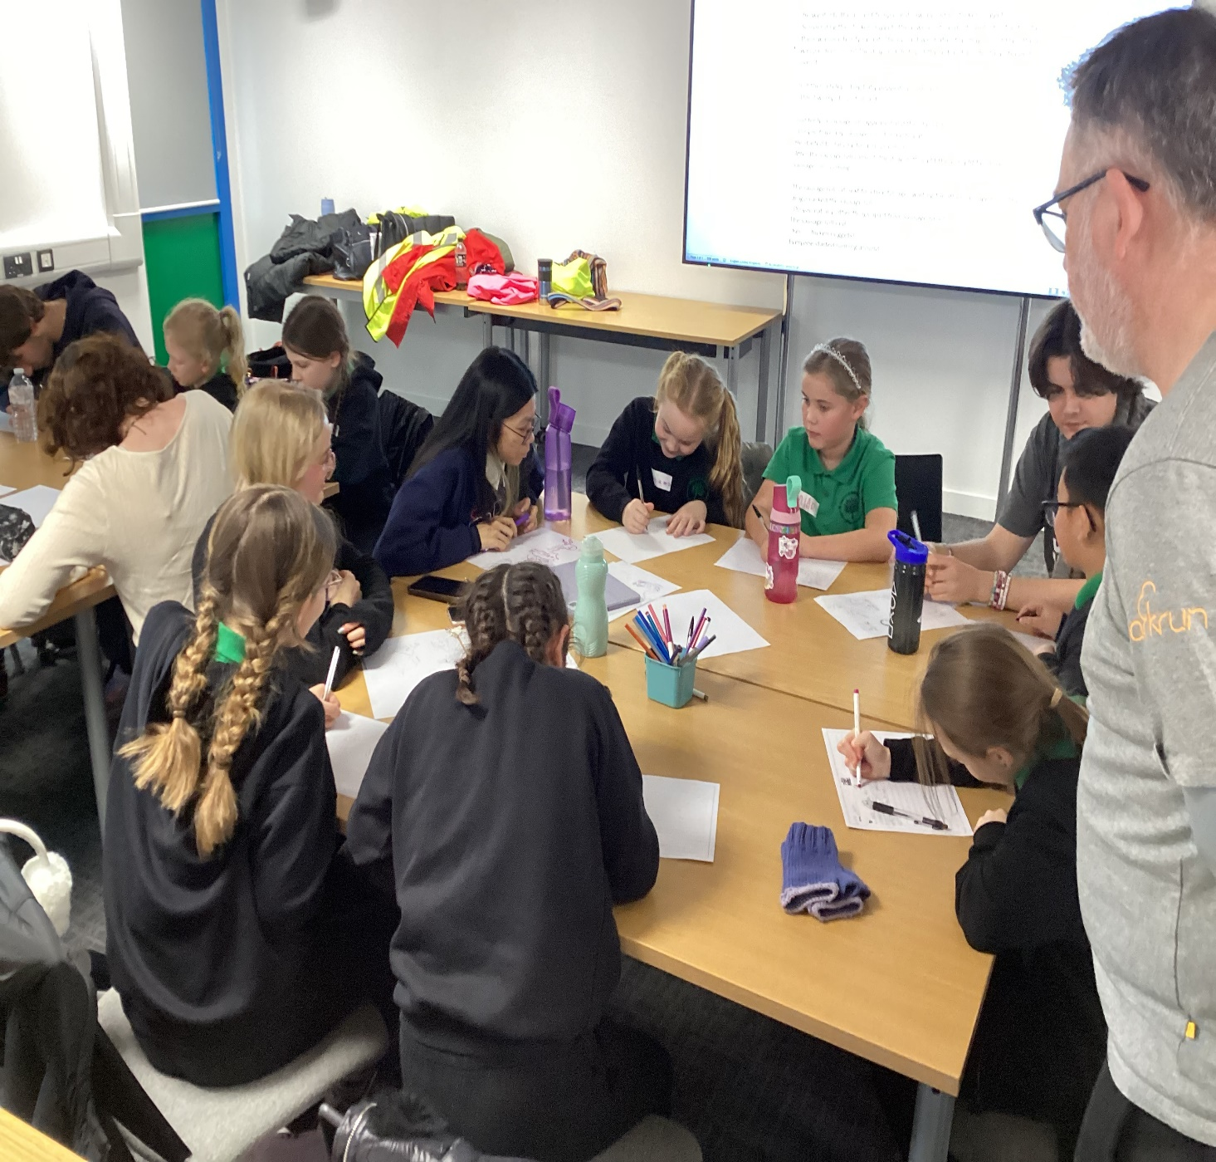
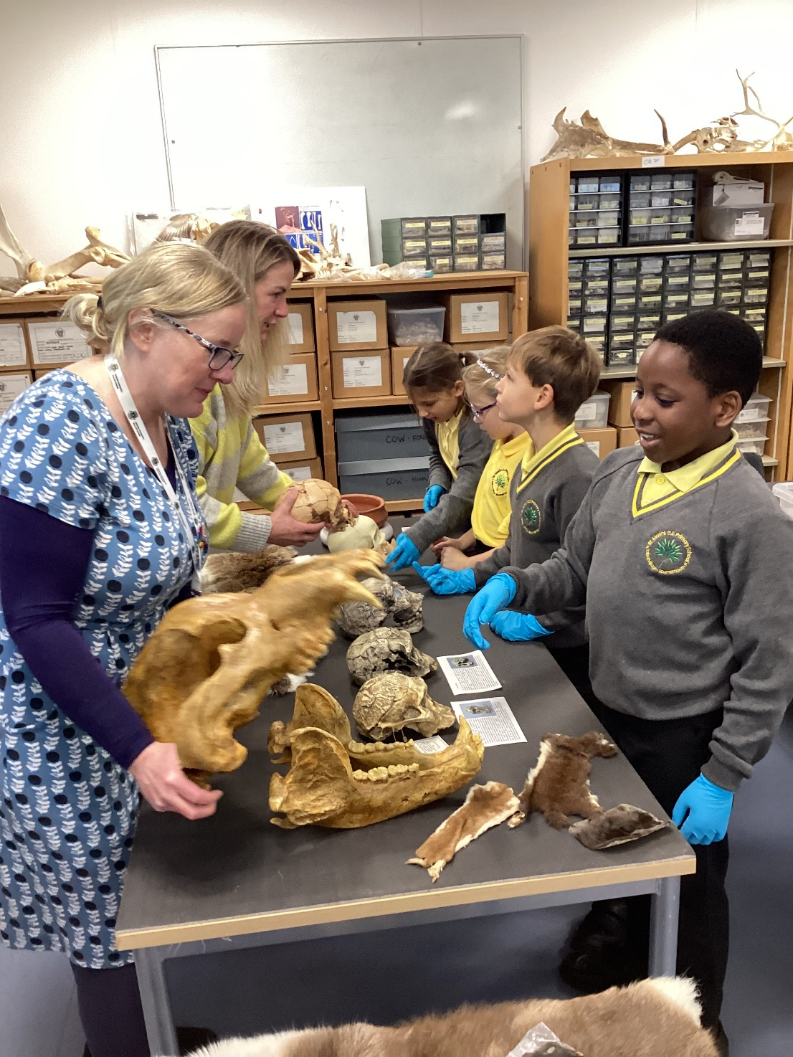
An archaeological dig at Bournemouth university
Storyworks at Bournemouth university

Slide 8
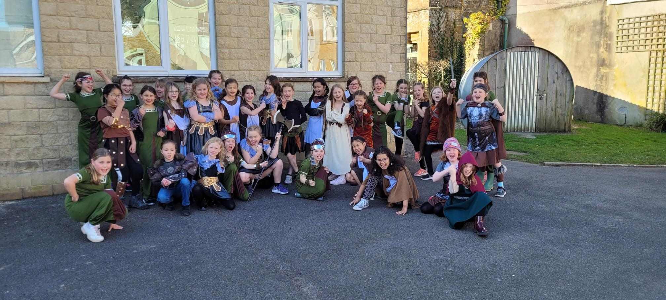
Viking invasion at Hooke Court!

Slide 9
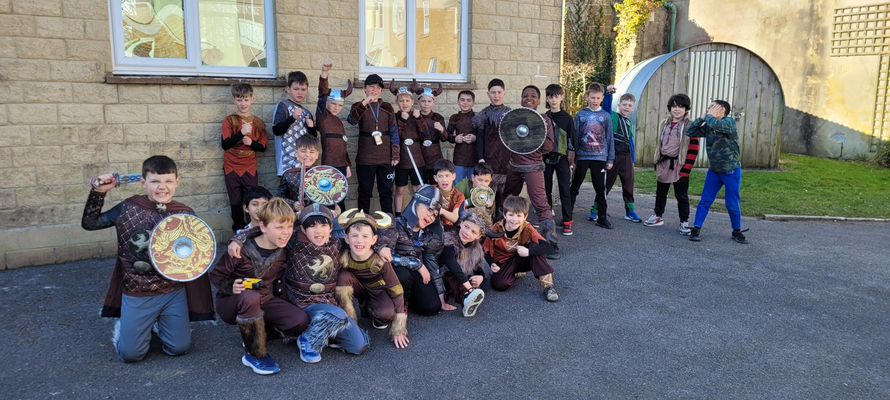
Viking invasion at Hooke Court!

Slide 10
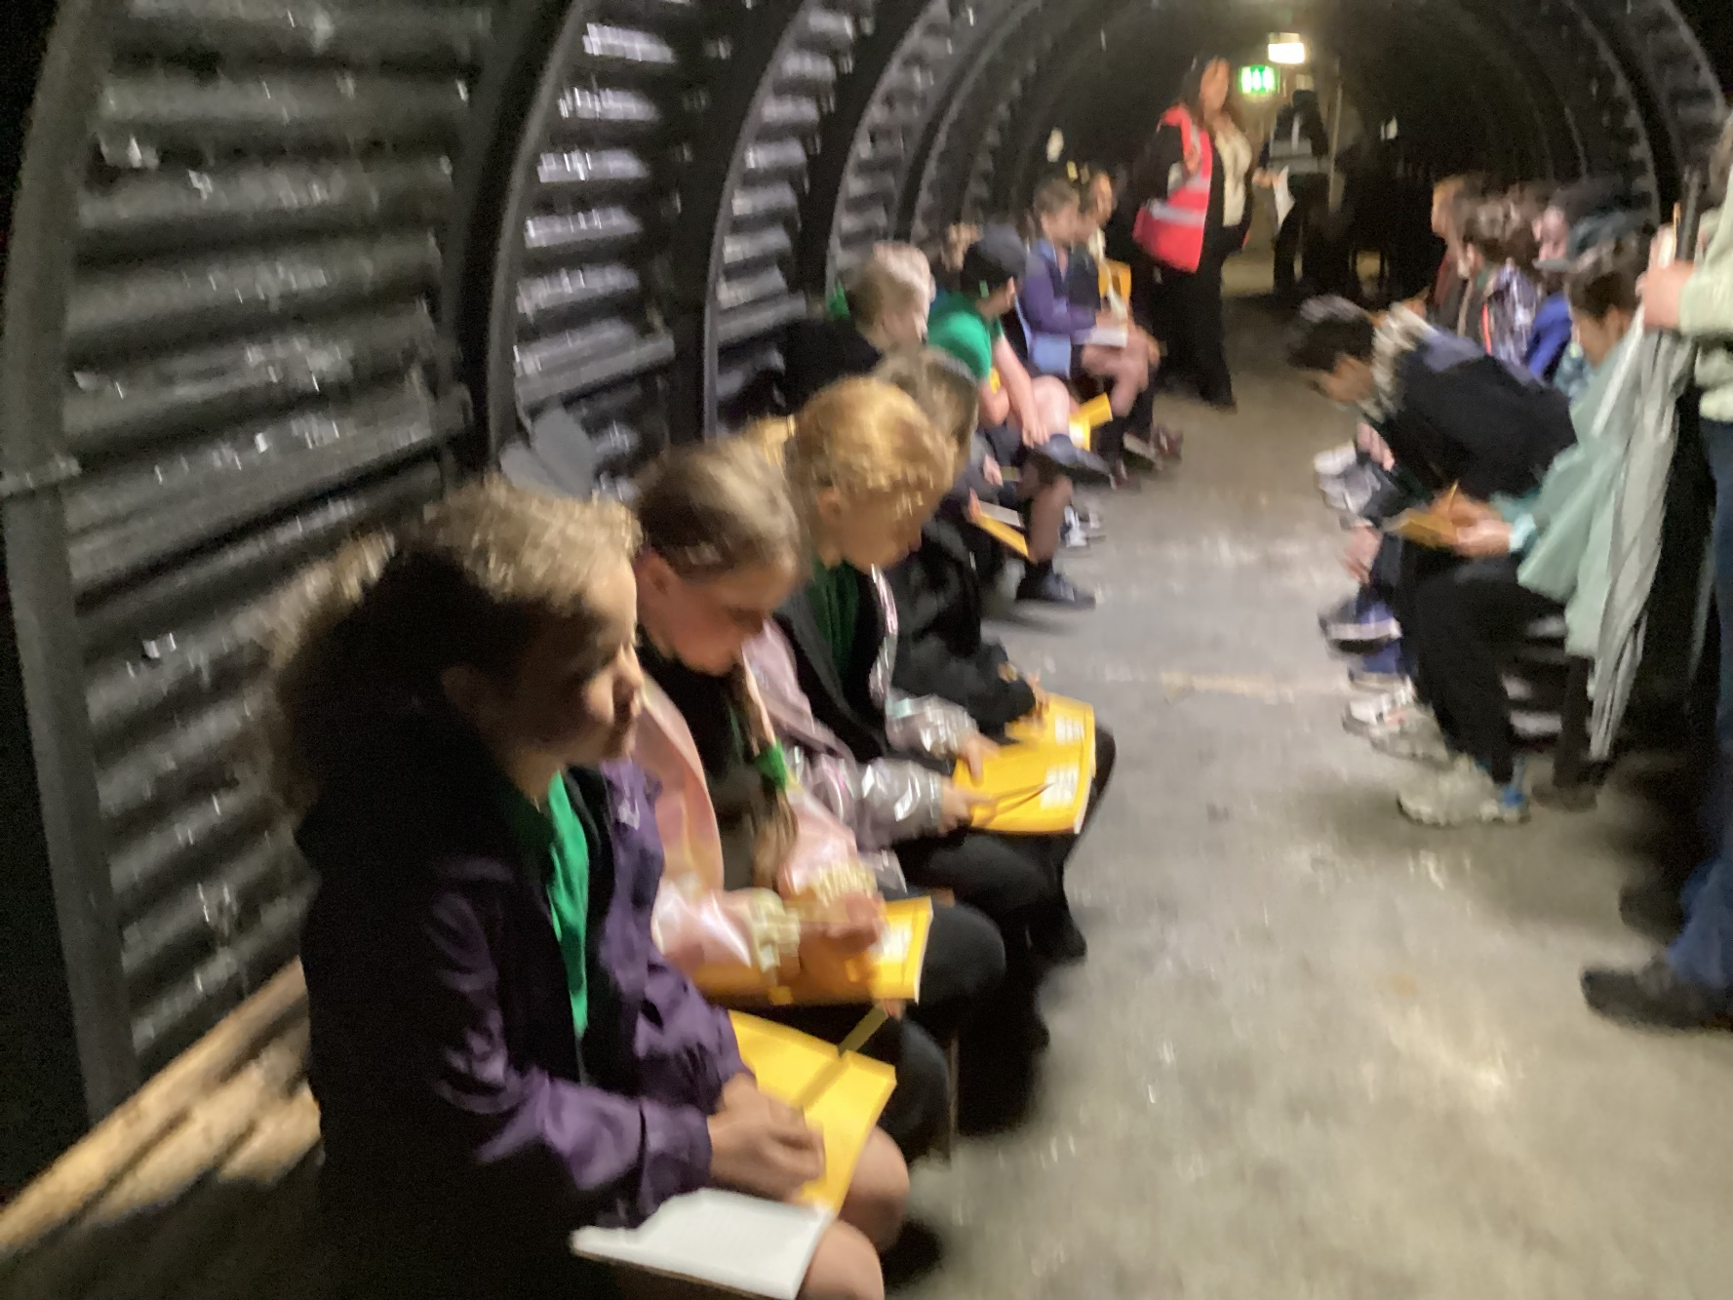
Visiting a World War Two Bunker at Talbot Heath

Slide 11
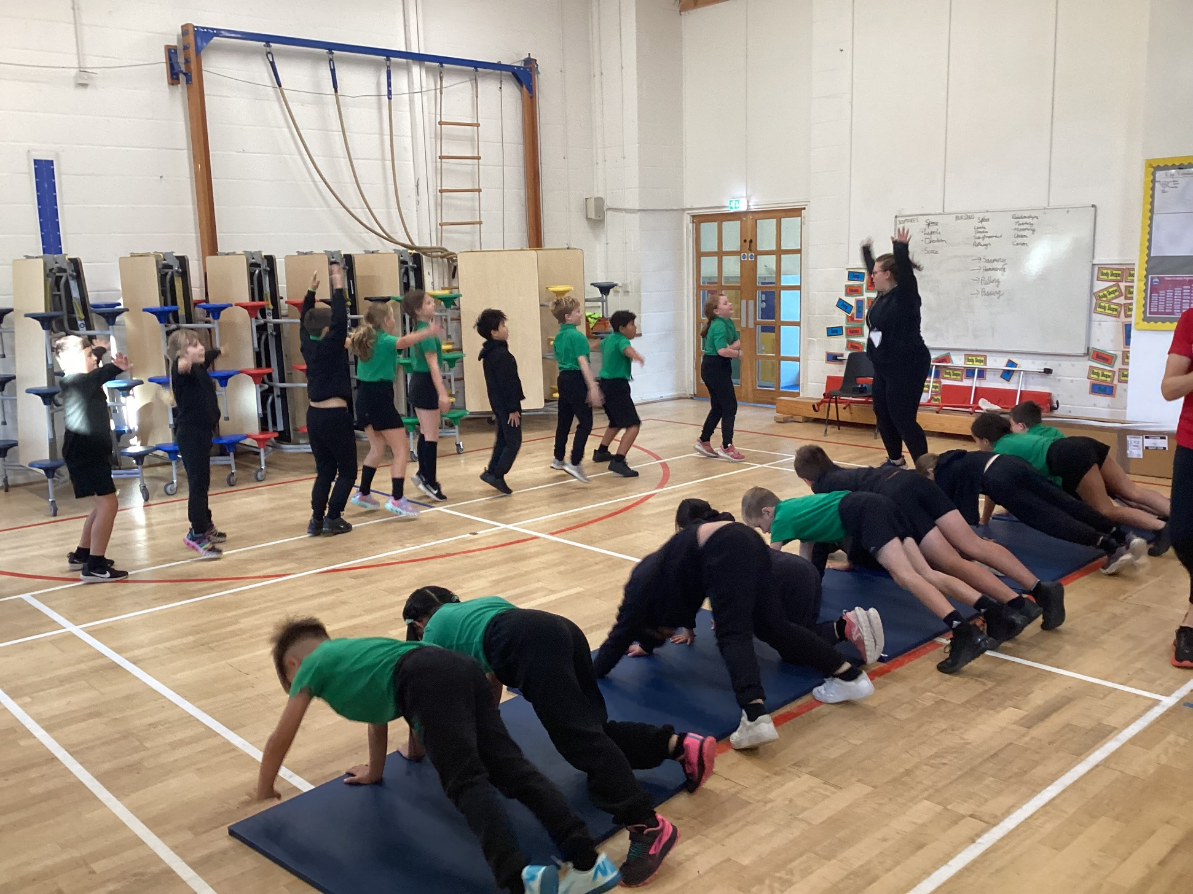
An Olympic athlete in a year four
sport lesson

Slide 12

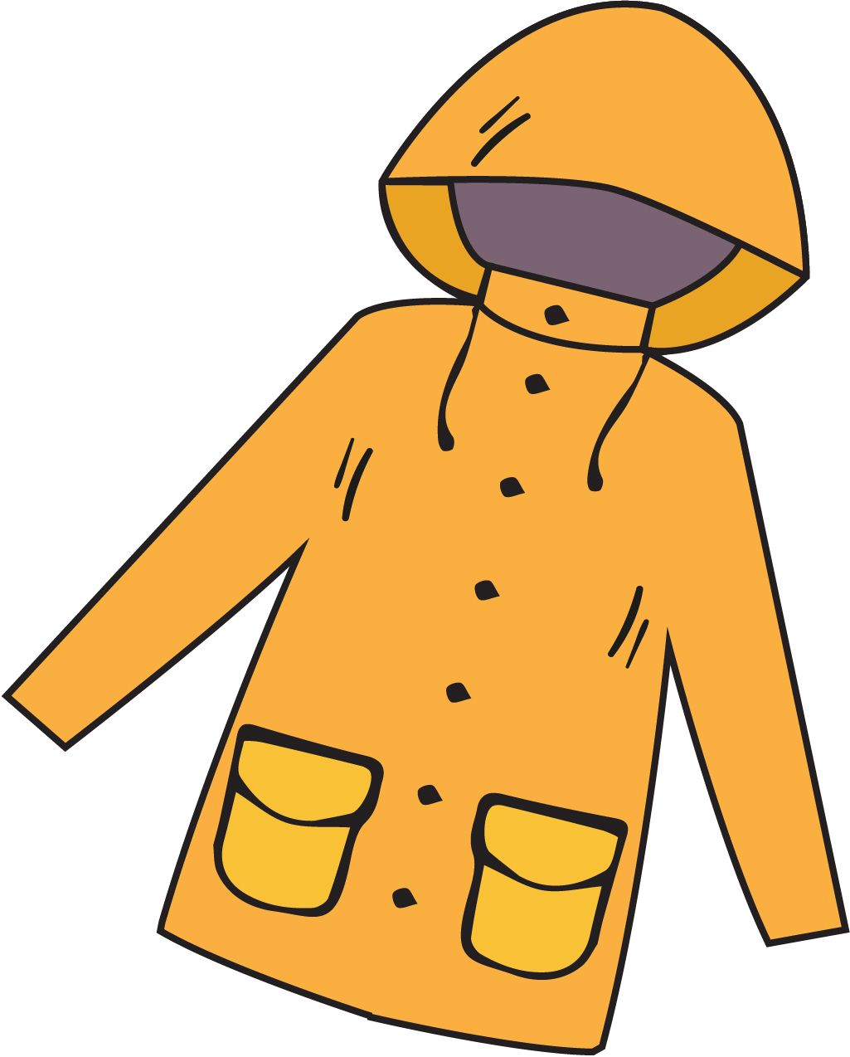

What do I need to bring?
All stationery your child requires will be provided by the school
School planner
Reading book from home (optional)
Water bottle
Morning snack (fruit/veg)
Waterproof coat
Trainers (for break / lunchtime football)
*Please ensure all items are named – thank you!

Slide 13
School uniform:
Yellow polo shirt with school logo and grey V-neck jumper or cardigan
Black trousers or shorts / black knee-length skirt or pinafore / yellow & white checked summer dress
Black socks (ankle or knee length) or black tights
White socks with summer dresses only please
Black formal leather or leather-look school shoes
All hair at or below shoulder length must be tied back at all times
Hair should be off the face, clipped back and not obscuring sight.
Hair ties should be in appropriate colours and styles suitable to blend with school uniform (yellow/white bands)

Slide 14
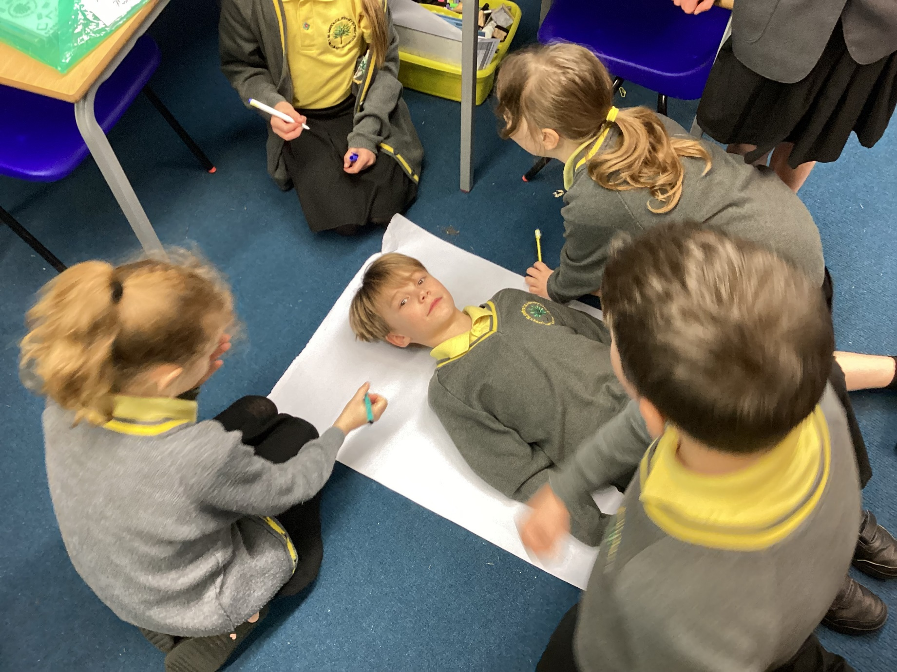

Slide 15
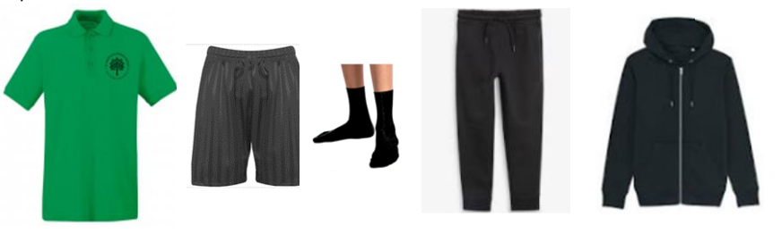

P.E Kit:
Emerald green short-sleeved polo shirt with logo
Plain black shorts
Short black socks
Plain black tracksuit for winter
Trainers only to be worn on P.E. days, but should be in school for break/lunchtime football.
Earrings must be removed & hair tied back and off the face
No gym/cycling shorts or leggings please

Slide 16














A selection of our Year 4 class texts:

Slide 17

Our Curriculum Intent:
We deliver a broad and balanced curriculum to develop a life-long love of learning. Our curriculum underpins our school vision statement of ‘flourishing together’ as it is ambitious for all.
Children will journey through St Mark’s with their passion for learning ignited and with their self-belief and wellbeing nurtured.
Every child will have the opportunity to flourish and will leave us prepared for a future of possibilities. Our curriculum responds to the needs of our children and enables them to shine academically and flourish socially, emotionally, morally and culturally whilst ‘loving God’ and ‘serving others’.

Slide 18
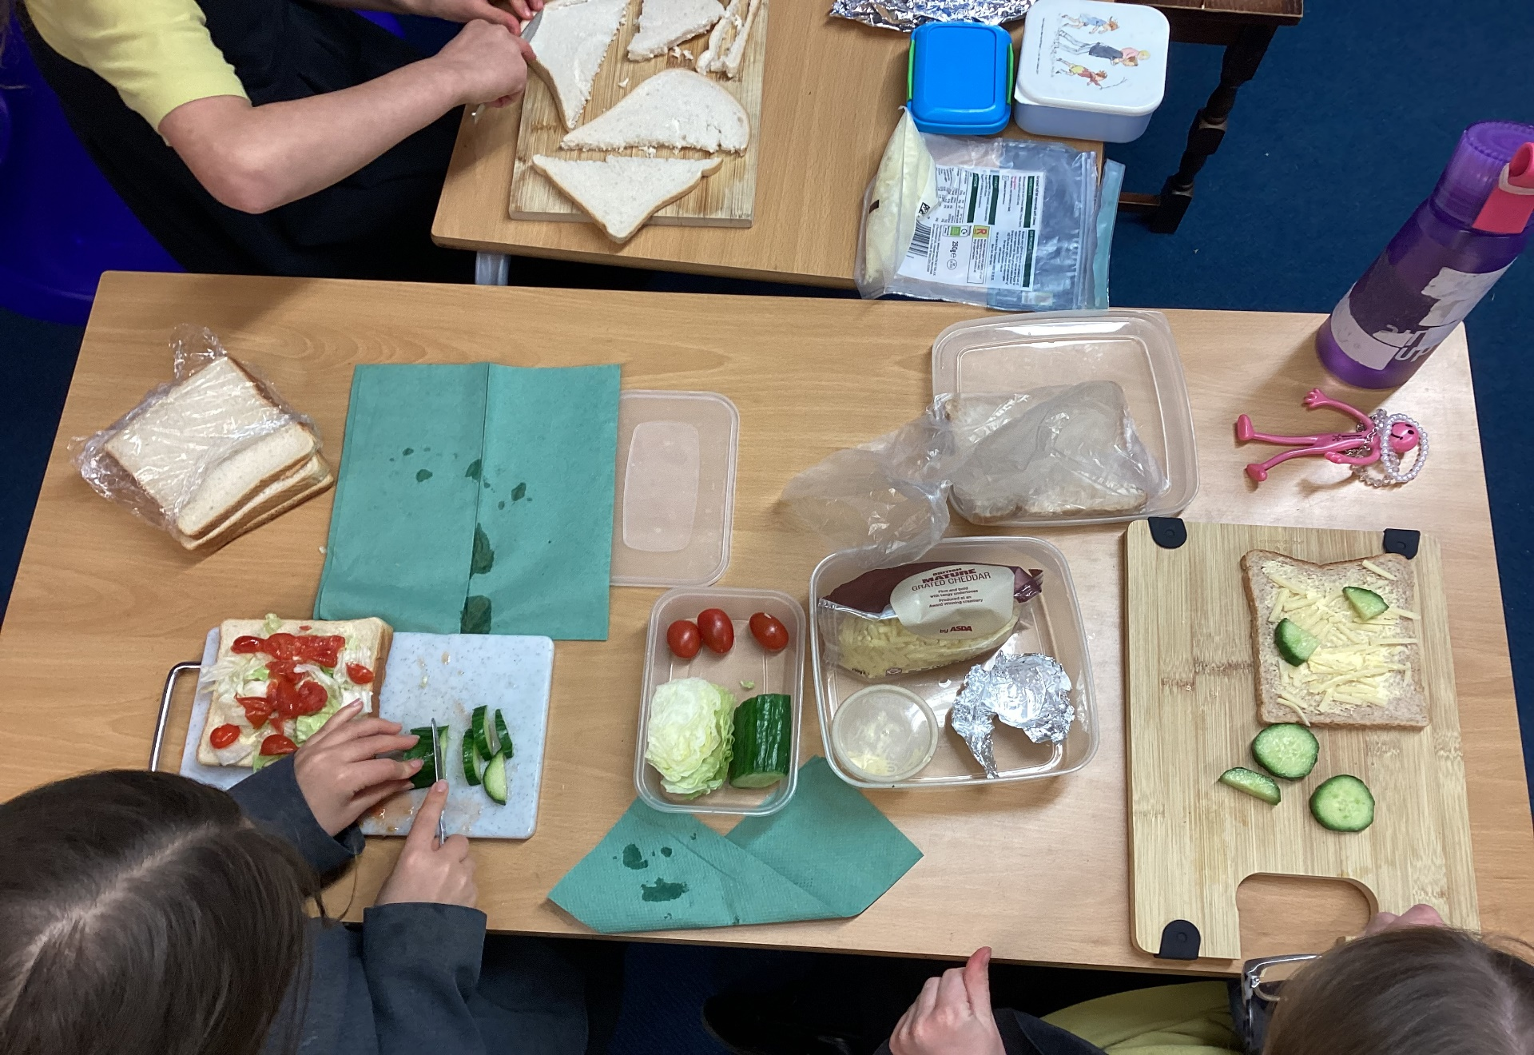
Making sandwiches in a D.T. lesson.

Slide 19
How is the week structured?
English (including reading, writing, grammar, spelling & handwriting) and Maths are taught daily
Weekly timetable includes P.E, R.E, Science, Music, French & PSHE (including Trick Box)
Geography, History, Computing, Art & Design and Design Technology will be taught in units throughout the year
As each subject area is taught discretely, children are taught to appreciate the distinctive uniqueness of individual subjects and aspire to become future scientists, computer coders, historians, etc.

Slide 20


Curriculum:
English: We will continue to use our own bespoke curriculum to deliver our English lessons through the use of high-quality texts as a basis to develop the children’s writing and appreciation of spelling, punctuation and grammar. Children will be given the opportunity to write for a range of contexts, purposes and audiences.

Slide 21

The importance of reading:
Language is a means to communicating effectively, but it is also the doorway to magical and exciting worlds.
Through a carefully planned and language-rich curriculum, we seek to enable our learners to become confident communicators, who are equipped to succeed now and in the future.
Quality texts are at the heart of our curriculum and we seek to foster a love of reading. We recognise that fluency in reading enables children to have access to the full curriculum entitlement. We seek to develop a passion for reading for pleasure and enjoyment.

Slide 22
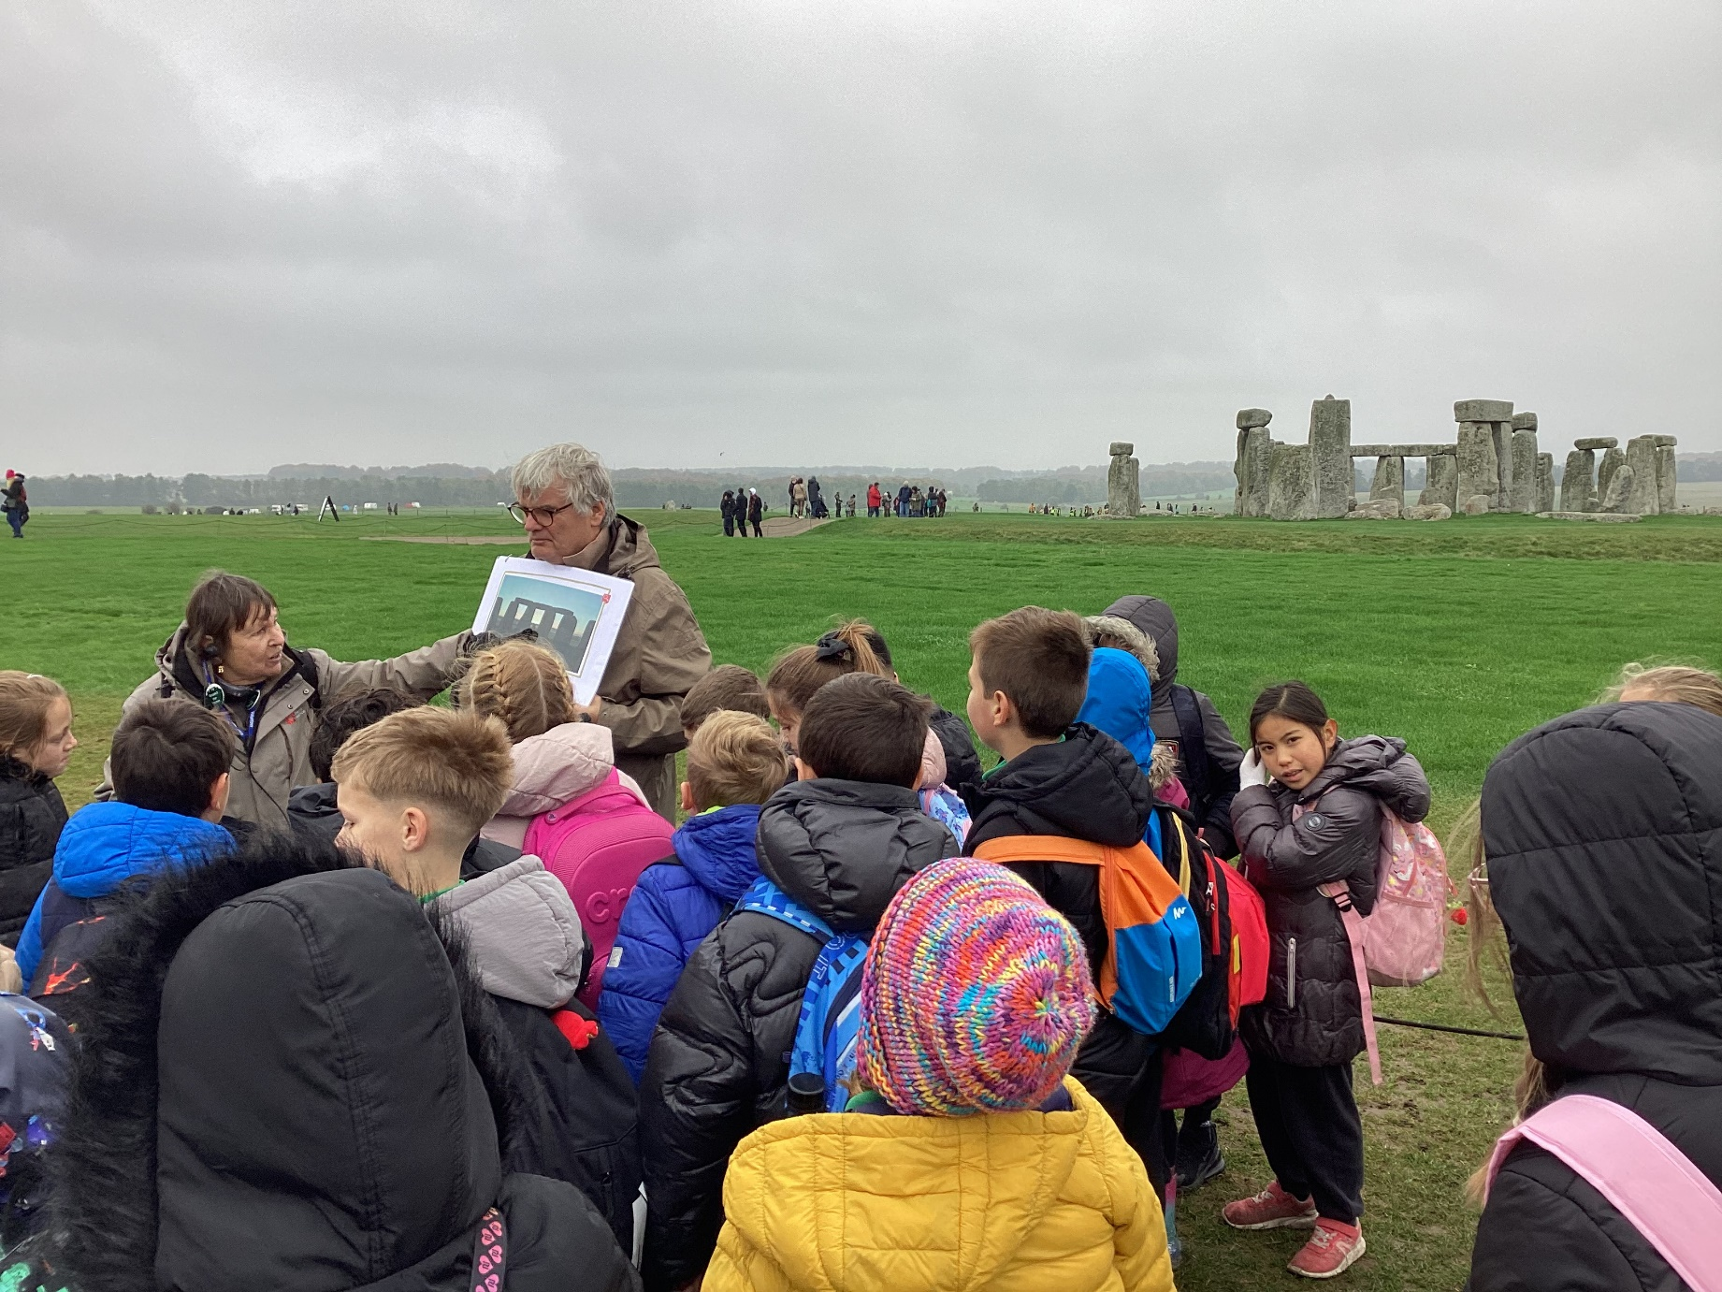
Visiting Stonehenge and exploring the past

Slide 23



Curriculum:
Maths:
We will continue to use the White Rose scheme of learning to deliver high-quality mathematics lessons with a focus on developing the children’s mathematical fluency, as well as their ability to problem solve and apply their learning to different real-life contexts.

Slide 24

Curriculum:
Religious Education:
As a Church of England school, faith and belief play a key role in the life of the school and our curriculum is centred around our vision statement of ‘loving God’.
We value R.E as a core subject and encourage an enquiry-based approach to learning about Christianity and other faiths.
The children will have weekly R.E lessons, as well as daily acts of worship.

Slide 25
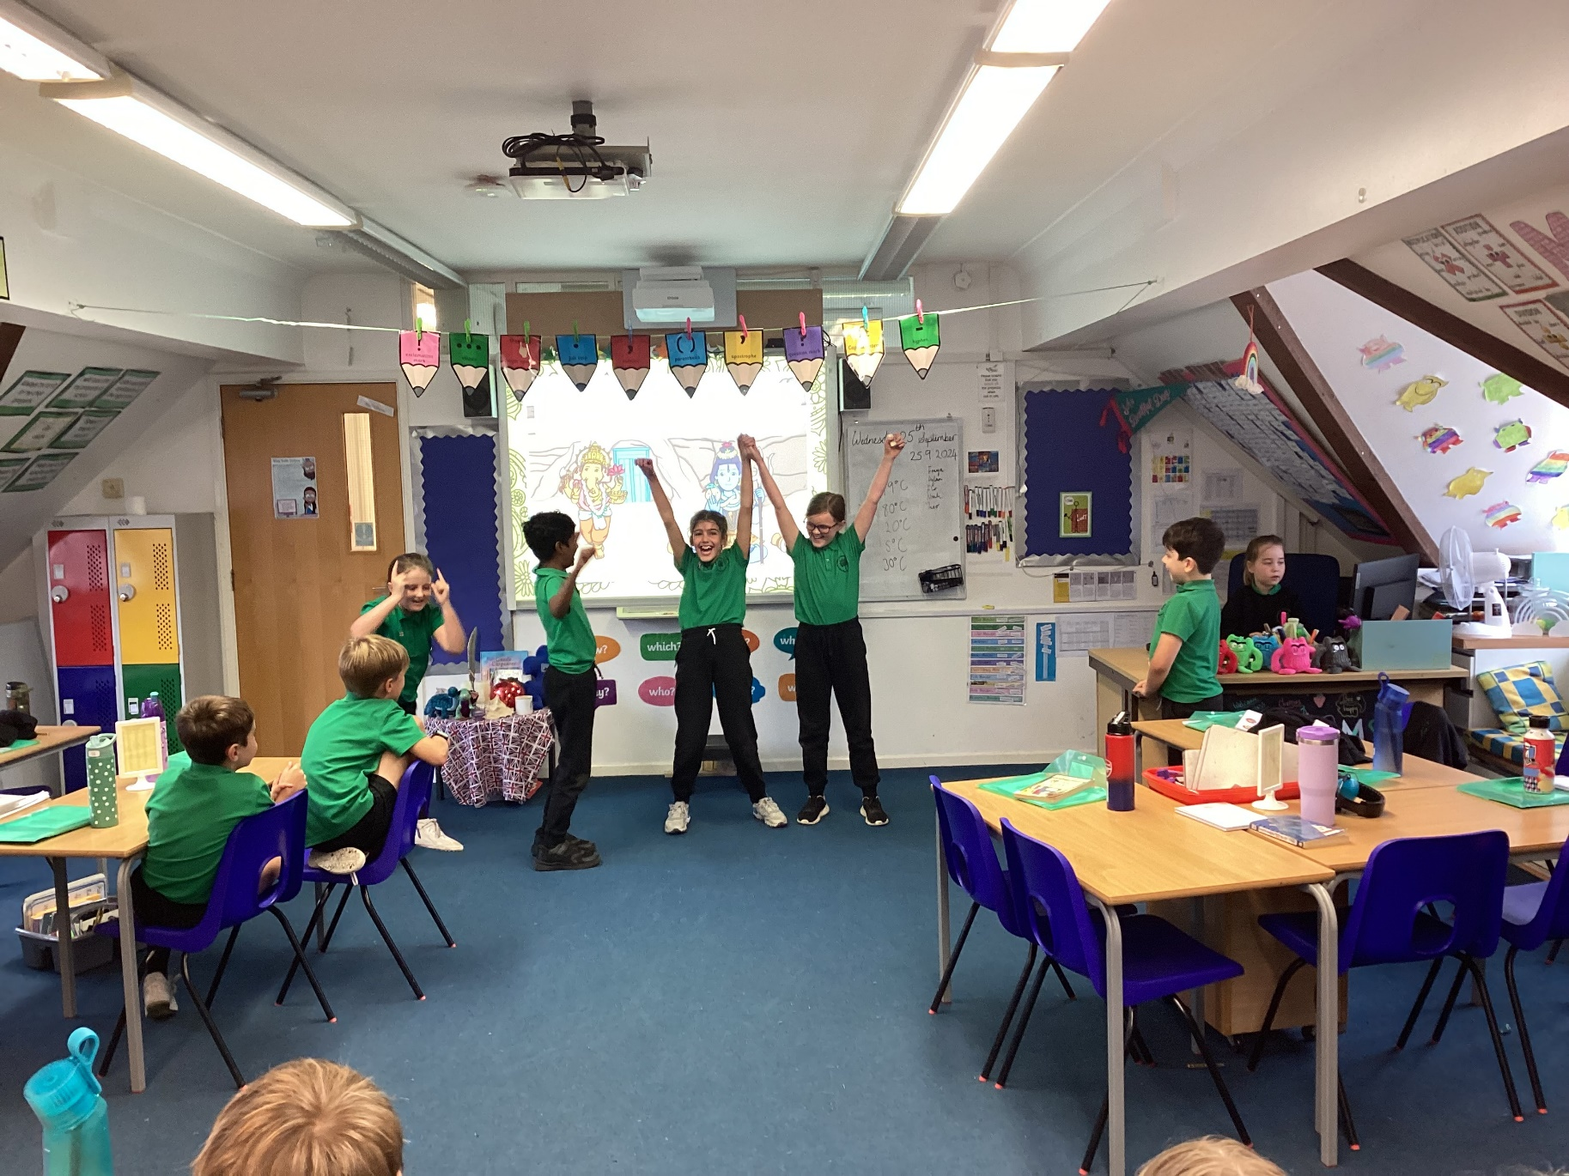
Drama in an R.E. Lesson

Slide 26

Feedback:
Focus on verbal feedback
Dialogue with your child, focusing on their next steps
Use of feedback code in books

Slide 27

ICT Agreement:
St Mark’s Primary School invite each pupil to sign a pupil agreement which can be found on page 5 of your child’s weekly reading planner.
Read the agreement with your child and ensure that they understand how to safe online. Ask your child to sign the agreement and E-safety rules.

Slide 28


Homework Expectations:
Weekly expectation: 1 x maths task / daily reading / weekly practising of times tables/ Multiplication check and spellings
Maths task:
Accessed via Microsoft Teams
Consolidates learning covered in class
Set on a Friday and due in by 7pm the following Wednesday

Slide 29

Walking home passport:
St Mark’s Primary School would like to provide your child with a walking home passport. This will allow them to walk home with your permission.
The walking passport will be inside your child’s weekly planner.
This must be accompanied by an email from their parent or carer.

Slide 30



Reading - children are asked to read a wide variety of genres at least 4 times a week at home. Please sign their planner each week to acknowledge this.
Weekly spellings – focus on spelling patterns and common exception words. Words will be accessible to practise on Spelling Shed.
Times tables – practise quick recall of multiplication facts up to 12x12 and their corresponding division facts.

Slide 31

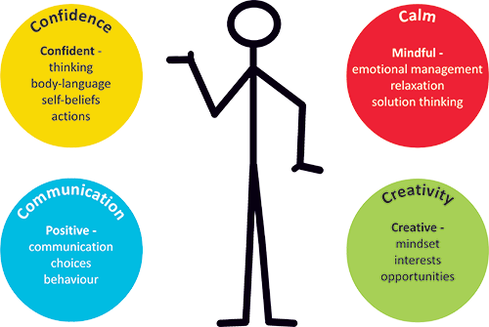

Mental health and well-being:
Trick Box:
Supports mental health and wellbeing
Taught a series of tricks to help deal with everyday situations
Promotes important skills: resilience, independence, etc.

Slide 32
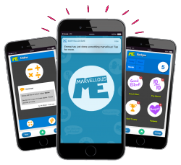

Marvellous Me:
We will continue to use Marvellous Me to share updates on your child’s learning and celebrate their success.

Slide 33
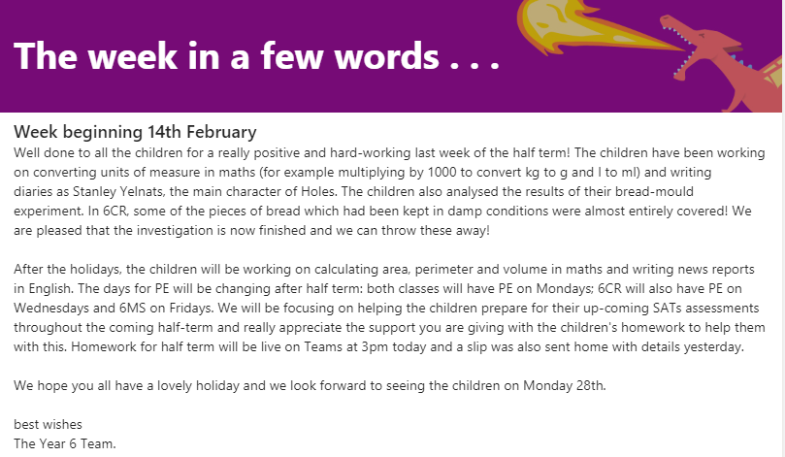
A week in a few words:
We will continue to post a weekly summary of your child’s learning on Microsoft TEAMS. We will also endeavour to inform you of what we will be covering during the following week.

Slide 34
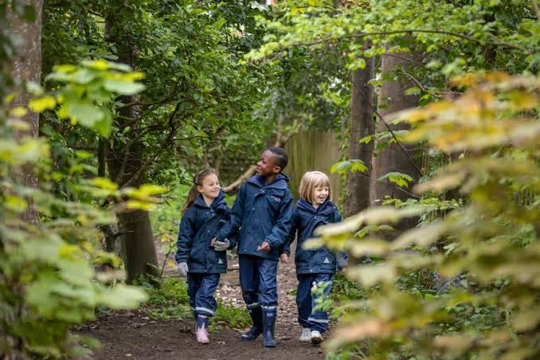
Woodland explorers

Slide 35

S & PA
Can you help with School disco, the Christmas or summer fayre or even some of the wider events?

Slide 36

Any questions? …
Thank you for listening.

Slide 37


Vision and Values:

