Slide 1


Year 5

Slide 2
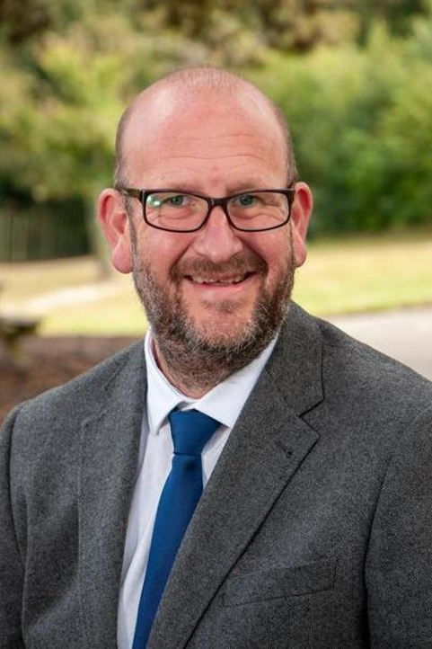
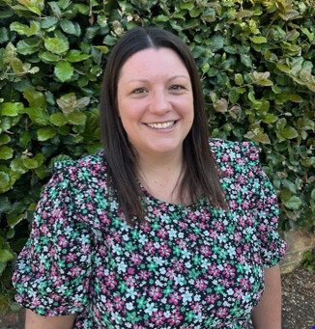
The Year 5 Team:
Class teachers:
5AH
5CS
Mr Hall
Miss Salter

Slide 3
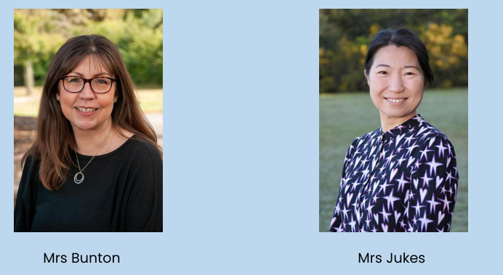
The Year 5 Team:
Teaching Assistants:

Slide 4


Vision and Values:

Slide 5



What does my child need to bring?
All stationery your child requires will be provided by the school (pens, no pencil cases)
School planner
Reading book – home or school
Water bottle
Optional morning snack (fruit/veg)
Waterproof coat
Trainers (for break / lunchtime football)
*Please ensure all items are named – thank you!

Slide 6
School uniform:
Yellow polo shirt with school logo and grey V-neck jumper or cardigan
Black trousers or shorts / black knee-length skirt or pinafore / yellow & white checked summer dress
Black socks (ankle or knee length) or black tights
White socks with summer dresses only please
Black formal leather or leather-look school shoes
All hair at or below shoulder length must be tied back at all times
Hair should be off the face, clipped back and not obscuring sight.
Hair ties should be in appropriate colours and styles suitable to blend with school uniform (yellow/white bands)

Slide 7


P.E Kit:
Emerald green short-sleeved polo shirt with logo
Plain black shorts
Short black socks
Plain black tracksuit for winter
Trainers only to be worn on P.E. days but should be in school for break/lunchtime football.
Earrings must be removed & hair tied back and off the face
No gym/cycling shorts or leggings please

Slide 8

Our Curriculum Intent:
We deliver a broad and balanced curriculum to develop a life-long love of learning. Our curriculum underpins our school vision statement of ‘flourishing together’ as it is ambitious for all.
Children will journey through St Mark’s with their passion for learning ignited and with their self-belief and wellbeing nurtured.
Every child will have the opportunity to flourish and will leave us prepared for a future of possibilities. Our curriculum responds to the needs of our children and enables them to shine academically and flourish socially, emotionally, morally and culturally whilst ‘loving God’ and ‘serving others’.

Slide 9
How is the week structured?
English (including reading, writing, grammar, spelling & handwriting) and maths are taught daily.
Weekly timetable includes P.E, R.E, Science, Music, French & PSHE (including Trick Box), Geography, History and Computing
Art and Design Technology will be taught in special units throughout the year: Bridges, Doodlers, Express Yourself, Cityscapes, Chinese Inventions, Vases
As each subject area is taught discretely, children are taught to appreciate the distinctive uniqueness of individual subjects and aspire to become future scientists, computer coders, historians, etc.

Slide 10

Curriculum:
English:
English is divided into distinct parts: writing, reading, handwriting, spelling and punctuation and grammar.
Writing will focus on creating a writing journey where children will gain skills through interacting with high-quality example texts and exploring how they are constructed.
Children will then be guided to use what they have discovered in their own writing. For instance, this term, we will use parts of The Boy at the Back of Class to write formal letters and character descriptions

Slide 11

Curriculum:
Writing will focus on creating a writing journey where children will gain skills through interacting with high-quality example texts and exploring how they are constructed.
Children will then be guided to use what they have discovered in their own writing. For instance, this term, we will use parts of The Boy at the Back of Class to write formal letters and character descriptions

Slide 12

Curriculum:
Reading
There are two guided reading lessons each week. These will include a study of a class book as well as a lesson focussed on developing comprehension skills.
Our first book will explore Roman Britain where we’ll be studying elements of non-fiction writing.

Slide 13


Curriculum:
Handwriting
There will be three short focussed handwriting sessions each week. Children are expected to work in handwriting pen in all areas other than maths.
Punctuation and Grammar
There is a dedicated session each week where we work through the extensive grammar and punctuation curriculum from using semi-colons to constructing relative clauses and everything in between.

Slide 14

Curriculum:
Spelling
We will continue to use EdShed to deliver our spelling programme.
This can be supported by playing the interactive games at home as well as through traditional methods.
Spellings tested and issued on Mondays.
Common Exception Words.

Slide 15

The importance of reading:
Language is a means to communicating effectively, but it is also the doorway to magical and exciting worlds.
Through a carefully planned and language-rich curriculum, we seek to enable our learners to become confident communicators, who are equipped to succeed now and in the future.
Quality texts are at the heart of our curriculum and we seek to foster a love of reading. We recognise that fluency in reading enables children to have access to the full curriculum entitlement. We seek to develop a passion for reading for pleasure and enjoyment.

Slide 16

The importance of reading
Returning books – if anyone thinks they may still have book band or library books at home, please do bring them in, either to the office or to us.
Developing reading for pleasure – the importance of reading and enjoying books cannot be overstated – it has a huge impact on all areas of learning and on positive mental health and self-esteem.
We know it can be tricky to find books that children will want to read at home. Please do take a look at our Recommended Reading List, which can be found on the school website, but also do ask us if you’d like further support with identifying books your children might like.
https://www.st-marks.bournemouth.sch.uk/recommended-book-lists/

Slide 17


Slide 18

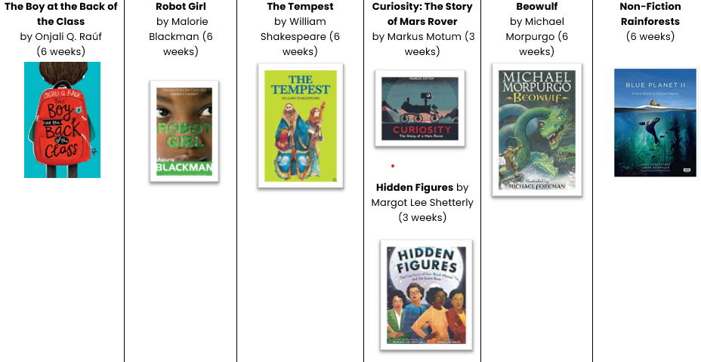


Our Reading Offering

Slide 19


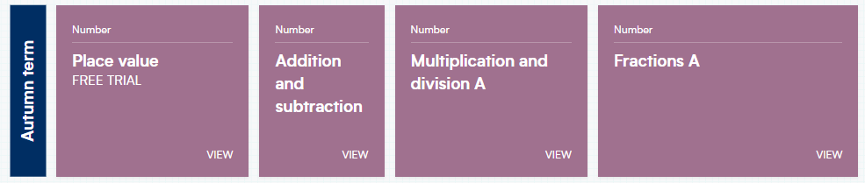

Curriculum:
Maths:
We will continue to use the White Rose scheme of learning to deliver high-quality mathematics lessons with a focus on developing mathematical fluency, as well as the ability to problem solve and apply learning to different real-life contexts.

Slide 20
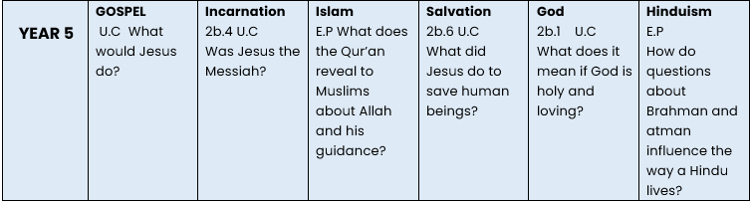

Curriculum:
Religious Education:
As a Church of England school, faith and belief play a key role in the life of the school and our curriculum is centred around our vision statement of ‘loving God’.
We value R.E as a core subject and encourage an enquiry-based approach to learning about Christianity and other faiths.
The children will have weekly R.E lessons, as well as daily acts of worship.
As well as the Christian Faith, we cover Islam and Hinduism in Y5.

Slide 21
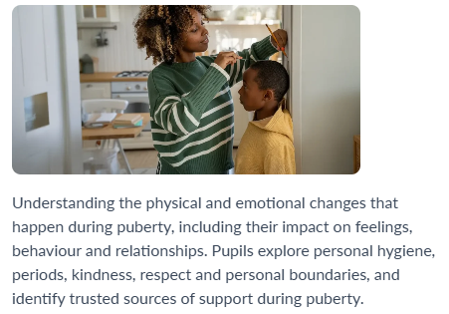
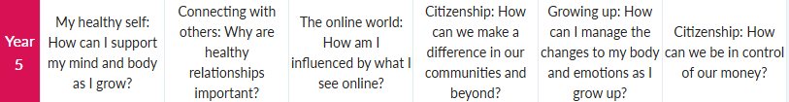

PHSE/ RSE
KAPOW – new scheme:

Slide 22




Mental health and well-being:
Trick Box:
Supports mental health and wellbeing
Taught a series of tricks to help deal with everyday situations
Promotes important skills: resilience, independence, etc.

Slide 23
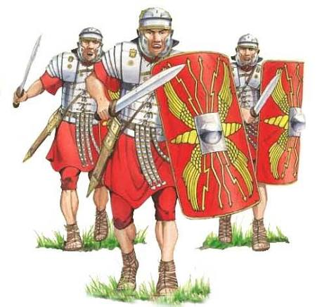
History and Geography
Autumn Term
Roman Britain & Using Maps
Spring Term
Saxons and Scots & London
Summer Term
The Industrial Revolution & Rainforests

Slide 24
Weekly Timetable:
Daily act of worship
P.E: twice a week
5CS: Monday (out) and Thursday (in)
5AH: Monday (out) and Friday (in)
Spelling test on Monday / Times tables on a Friday

Slide 25
Curriculum:
So, the for the start of the year, the curriculum looks like this:
Maths: Place Value
English: Writing: Formal Letters, character descriptions
Reading: Non-fiction texts
Spellings: EdShed (starting with –tious and –ious), Handwriting: Assessment, G&P: ending sentences
Science: Properties of materials RE: What would Jesus Do?
History: Roman Britain Computing: Coding French: Foods
Music: Livin’ On a Prayer PHSE: My Healthy Self PE: In and Out

Slide 26

Educational Visits:
We enhance and enrich the curriculum through a variety of activities: educational trips and visitors, school performances, as well as extra-curricular lunchtime and after school clubs.
Dates to be confirmed:
Spring Term: Cranborne ATC (History topic of the Saxons and Scots) £30
Summer Term - Winchester Science Museum & Planetarium (Space topic) £26
**Please note, these trips are subject to contributions.

Slide 27


Homework Expectations:
Weekly expectation:
  1 x maths task
  Daily reading (at least 4)
  Weekly practising of times tables and spellings
Maths task:
Accessed and completed online via Microsoft Teams
Consolidates learning covered in class
Set on a Friday and due in by 7pm the following Wednesday

Slide 28



Reading - children are asked to read a wide variety of genres at least 4 times a week at home. Please sign their planner each week to acknowledge this.
Weekly spellings – focus on spelling patterns and common exception words. Words will be accessible to practise on Spelling Shed.
Times tables – practise quick recall of multiplication facts up to 12x12 and their corresponding division facts.

Slide 29
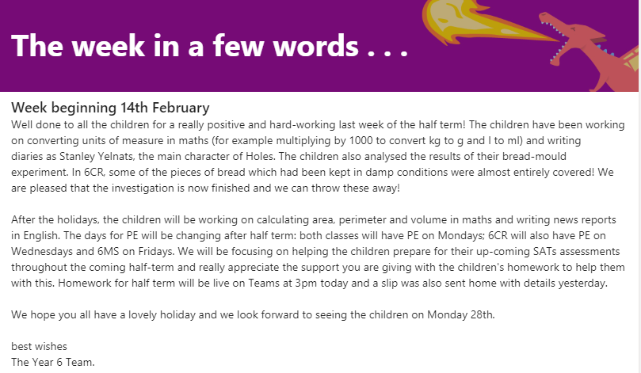
A week in a few words:
We will continue to post a weekly summary of your child’s learning on Microsoft TEAMS. We will also endeavour to inform you of what we will be covering during the following week.

Slide 30
Other important bits and pieces
Volunteers – help the children!
SMPA plea
Swimming
Woodland Explorers
Marvellous Me

Slide 31

Any questions? …
Thank you for listening.

