Slide 1


Year 3

Slide 2
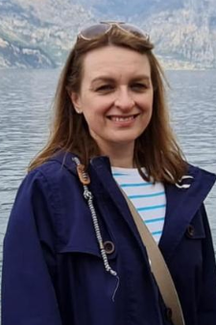
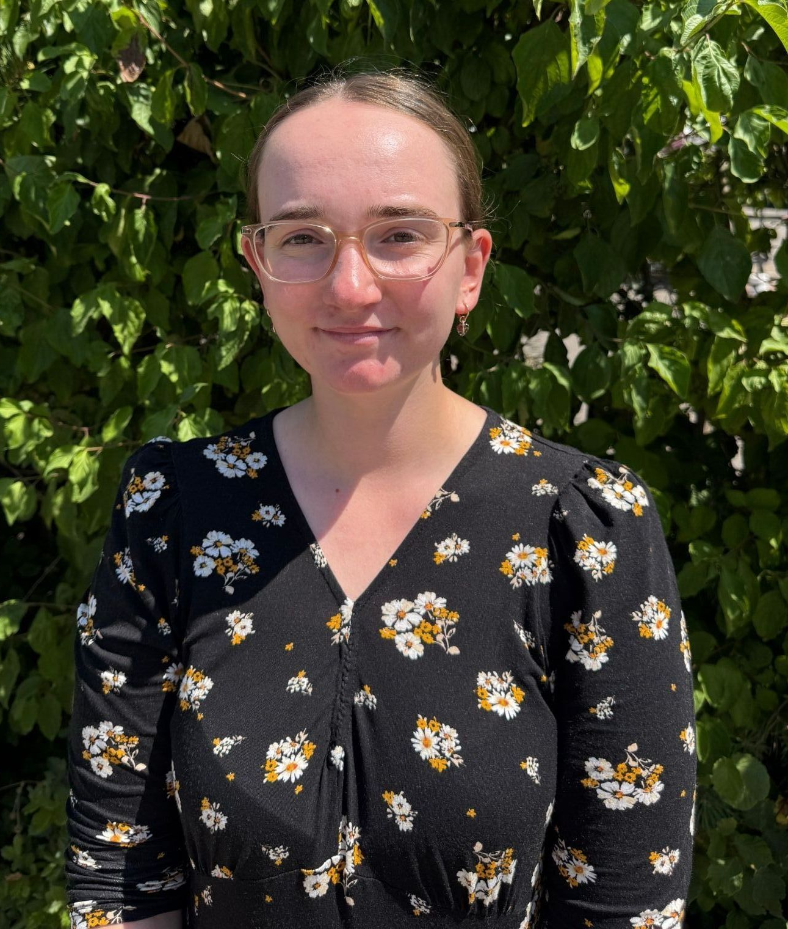
The Year 3 Team:
3JW
Class teachers:
3GC
Mrs Wilson
Miss Clement

Slide 3

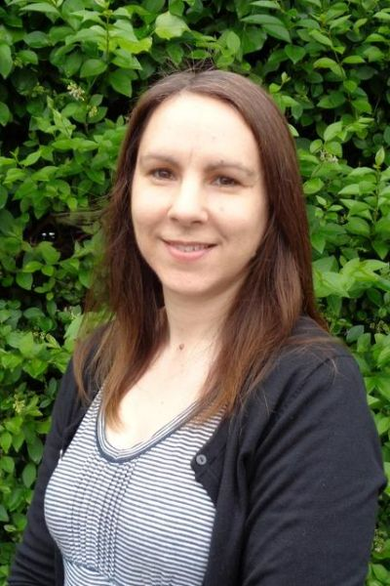
The Year 3 Team:
Teaching Assistants:
Mrs Somerset-Wilson
Mrs Whittle

Slide 4


Vision and Values:

Slide 5



What does my child need to bring?
All stationery your child requires will be provided by the school (caveat – handwriting pen)
School planner
Reading book from home/ school
Water bottle
Morning snack (fruit/veg)
Waterproof coat
Trainers (for break / lunchtime football)
*Please ensure all items are named – thank you!

Slide 6
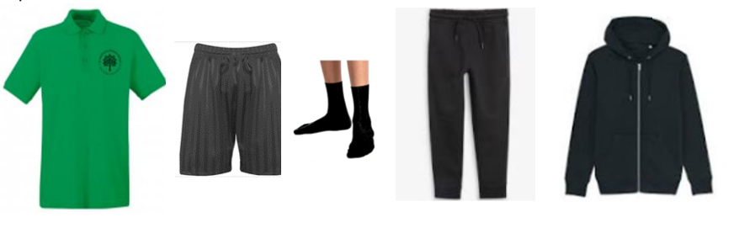

P.E Kit:
Emerald green short-sleeved polo shirt with logo
Plain black shorts
Short black socks
Plain black tracksuit for winter
Trainers only to be worn on P.E. days, but should be in school for break/lunchtime football.
Earrings must be removed & hair tied back and off the face
No gym/cycling shorts or leggings please

Slide 7
How is the week structured?
English (including reading, writing, grammar, spelling & handwriting) and Maths are taught daily
Weekly timetable includes P.E, R.E, Science, Music, French & PSHE
Geography, History, Computing, Art & Design and Design Technology will be taught in units throughout the year
As each subject area is taught discretely, children are taught to appreciate the distinctive uniqueness of individual subjects and aspire to become future scientists, computer coders, historians, etc.

Slide 8

Curriculum:
English
Across the school, our English lessons are planned with this structure in mind. Using quality texts, we develop our writing skills through oracy, exploration of text, grammar, spelling and explicit handwriting sessions.

Slide 9

The importance of reading
Returning books – if anyone thinks they may still have book band or library books at home, please do bring them in, either to the office or to us.
Developing reading for pleasure – the importance of reading and enjoying books cannot be overstated – it has a huge impact on all areas of learning and on positive mental health and self-esteem.
We know it can be tricky to find books that children will want to read at home. Please do take a look at our Recommended Reading List, which can be found on the school website, but also do ask us if you’d like further support with identifying books your children might like.
https://www.st-marks.bournemouth.sch.uk/recommended-book-lists/

Slide 10




A selection of our Year 3 class texts:

Slide 11



Curriculum:
Maths:
We will continue to use the White Rose scheme of learning to deliver high-quality mathematics lessons with a focus on developing the children’s mathematical fluency, as well as their ability to problem solve and apply their learning to different real-life contexts.

Slide 12

Curriculum:
Religious Education:
As a Church of England school, faith and belief play a key role in the life of the school and our curriculum is centred around our vision statement of ‘loving God’.
We value R.E as a core subject and encourage an enquiry-based approach to learning about Christianity and other faiths.
The children will have weekly R.E lessons, as well as daily acts of worship.
Aut 1 – Hinduism Aut 2 – Incarnation
Sp 1 – Islam Sp 2 – Salvation
Sum 1 – Creation Sum 2 – People of God & Humanism

Slide 13

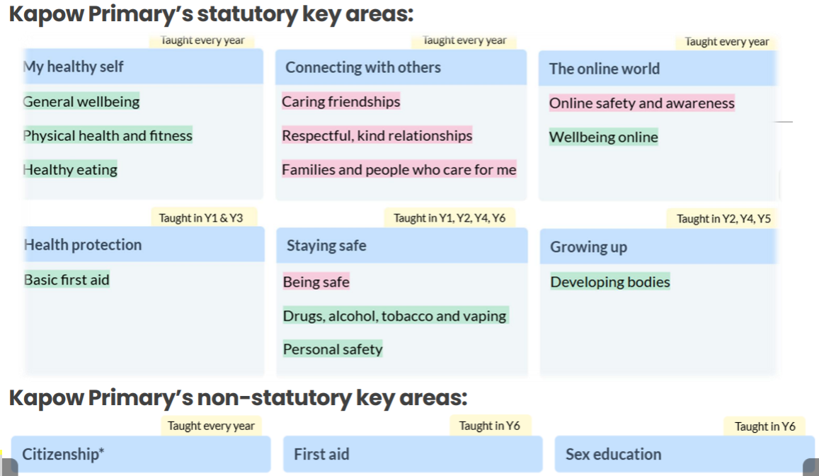
PSHE & RSE
This year we are using a new scheme of learning to enhance our delivery of the PSHE & RSE curriculum.
This is a spiral curriculum where topics are revisited throughout the child’s time at Primary school, in order to build on their prior learning.

Slide 14

History and Geography
Autumn Term
Mayans & South America
Spring Term
Egyptians & Jurassic Coast
Summer Term
Crime and Punishment & Extreme Earth

Slide 15

Feedback:
Focus on verbal feedback live in lessons
Dialogue with your child, focusing on their next steps
Use of school feedback code

Slide 16

Weekly Timetable:
Daily act of worship
P.E: twice a week
3GC: Hall Monday / Outside Thursday
3JW: Hall Wednesday/ Outside Thursday
Spelling test on Monday
Swimming pool status: Opening after Christmas

Slide 17
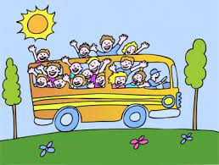
Educational Visits:
Science Zone – Bournemouth - Autumn
Egyptian drama morning- Spring
Etches Museum – Kimmeridge - Summer
Dates TBD.

Slide 18


Home Learning :
Weekly expectation: 1 x maths task / daily reading / weekly practising of times tables (TT Rockstars) and spellings (EdShed/worksheet)
Maths task:
Accessed and handed in via Microsoft Teams copy.
Consolidates learning covered in class
Set on a Friday and due in by 7pm the following Wednesday
This is highly valued - forming good habits with handing in on time is essential.

Slide 19



Reading - children are asked to read a wide variety of genres at least 4 times a week at home. Please sign their planner each week to acknowledge this.
Weekly spellings – focus on spelling patterns and common exception words. Words will be accessible to practise on Spelling Shed.
Times tables – practise quick recall of multiplication facts up to 12x12 and their corresponding division facts.

Slide 20

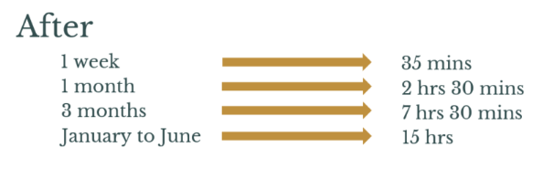
Spellings, reading, TTRS
5 minutes a day, everyday…

Slide 21

Rewards:
In KS2 we no longer have the sunshine and shooting star, however the children will be awarded merits directly and they are responsible for sticking them in their planners.
We still have the ‘We deserve a treat’ class reward system.
In Phase worship on a Friday, 2 children from each class will be awarded a values ambassador certificate. One child will be awarded a writer of the week certificate, and their work will be displayed in the classroom. At this worship, we will also hand out merit certificates. All of these children we get a colour token for their Colour Team.
.

Slide 22
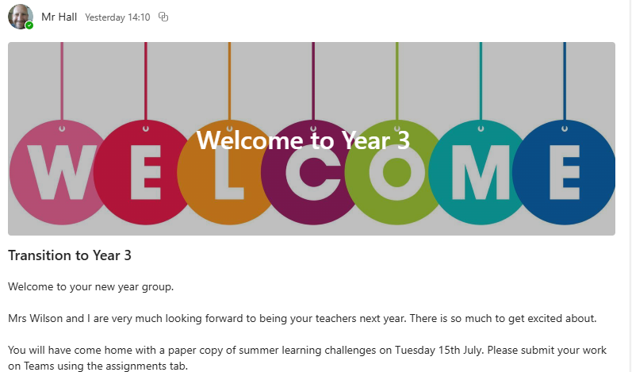
A week in a few words:
We will continue to post a weekly summary of your child’s learning on Microsoft TEAMS. We will also endeavour to inform you of what we will be covering during the following week.

Slide 23
How can you help your child?
Read at least 5 mins a day with them.
Talk about their day and what they have been learning.
Encourage them with their homework.
Encourage independence – giving them chances to make decisions and giving them the responsibility to ensure they have everything they need for the school day.
As a school we are focussing on helping the children to develop a Growth Mindset. Some language we might use to aid this would be “I can’t do it…..yet!”
Encourage your children to embrace making mistakes, after all, this is how we learn!

Slide 24


How can you help the school?
S&PA
Volunteer within school

Slide 25

Any questions? …
Thank you for attending.

