Slide 1


Year 2

Slide 2
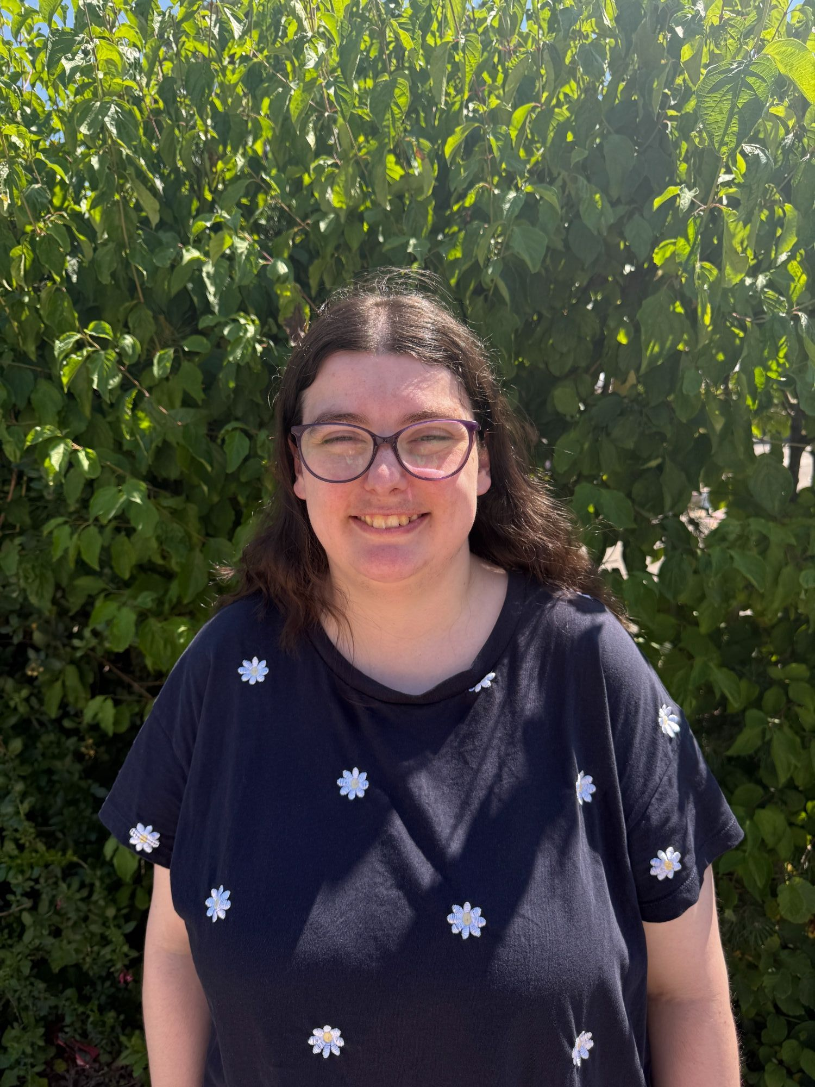
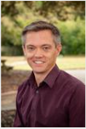
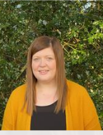
The Year 2 Team:
Class teachers:
2EM
2RK
Miss Martin
Mrs Rose
(Monday - Wednesday)
Mr Knight
(Thursday - Friday)

Slide 3
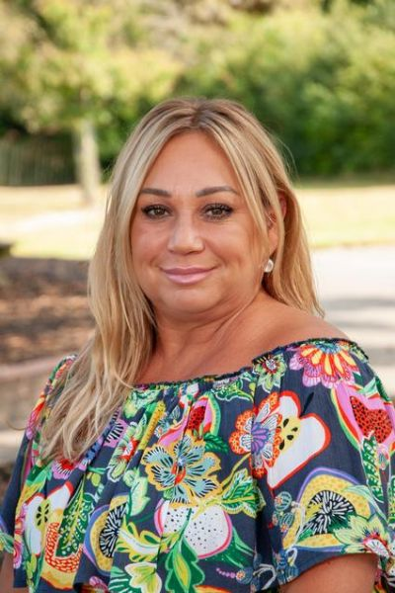
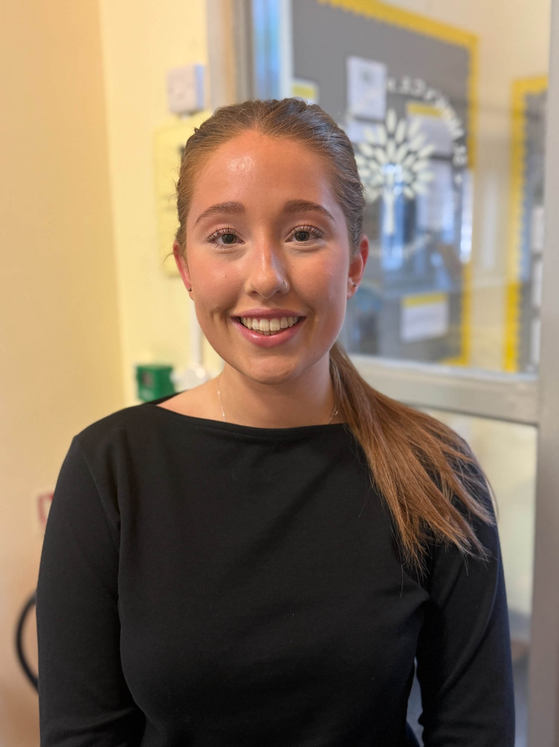
The Year 2 Team:
Teaching Assistants:
Miss Fade
Miss Hudson-Lambe

Slide 4


Vision and Values:

Slide 5



What does my child need to bring?
All stationery your child requires will be provided by the school
School planner
School reading book
Water bottle
Morning snack (fruit/veg)
Waterproof coat
Trainers (for break / lunchtime football)
*Please ensure all items are named – thank you!

Slide 6
School uniform:
Yellow polo shirt with school logo and grey V-neck jumper or cardigan
Black trousers or shorts / black knee-length skirt or pinafore / yellow & white checked summer dress
Black socks (ankle or knee length) or black tights
White socks with summer dresses only please
Black formal leather or leather-look school shoes
All hair at or below shoulder length must be tied back at all times
Hair should be off the face, clipped back and not obscuring sight.
Hair ties should be in appropriate colours and styles suitable to blend with school uniform (yellow/white bands)

Slide 7
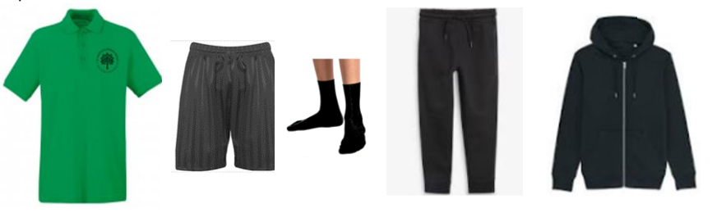

P.E Kit:
Emerald green short-sleeved polo shirt with logo
Plain black shorts
Short black socks
Plain black tracksuit for winter
Trainers only to be worn on P.E. days, but should be in school for break/lunchtime football.
Earrings must be removed & hair tied back and off the face
No gym/cycling shorts or leggings please

Slide 8

Our Curriculum Intent:
We deliver a broad and balanced curriculum to develop a life-long love of learning. Our curriculum underpins our school vision statement of ‘flourishing together’ as it is ambitious for all.
Children will journey through St Mark’s with their passion for learning ignited and with their self-belief and wellbeing nurtured.
Every child will have the opportunity to flourish and will leave us prepared for a future of possibilities. Our curriculum responds to the needs of our children and enables them to shine academically and flourish socially, emotionally, morally and culturally whilst ‘loving God’ and ‘serving others’.

Slide 9
How is the week structured?
English (including reading, writing, grammar, spelling & handwriting) and Maths are taught daily
Weekly timetable includes P.E, R.E, Science, French & PSHE (including Trick Box)
Geography, History, Computing, Art & Design, Design Technology and Music will be taught in units throughout the year
As each subject area is taught discretely, children are taught to appreciate the distinctive uniqueness of individual subjects and aspire to become future scientists, computer coders, historians, etc.

Slide 10

Curriculum:
English: We will continue to deliver our English lessons through the use of high-quality texts as a basis to develop the children’s writing and appreciation of spelling, punctuation and grammar. Children will be given the opportunity to write for a range of contexts, purposes and audiences.

Slide 11

The importance of reading:
Language is a means to communicating effectively, but it is also the doorway to magical and exciting worlds.
Through a carefully planned and language-rich curriculum, we seek to enable our learners to become confident communicators, who are equipped to succeed now and in the future.
Quality texts are at the heart of our curriculum and we seek to foster a love of reading. We recognise that fluency in reading enables children to have access to the full curriculum entitlement. We seek to develop a passion for reading for pleasure and enjoyment.

Slide 12





A selection of our Year 2 class texts:

Slide 13



Curriculum:
Maths:
We will continue to use the White Rose scheme of learning to deliver high-quality mathematics lessons with a focus on developing the children’s mathematical fluency, as well as their ability to problem solve and apply their learning to different real-life contexts.

Slide 14

Curriculum:
Religious Education:
As a Church of England school, faith and belief play a key role in the life of the school and our curriculum is centred around our vision statement of ‘loving God’.
We value R.E as a core subject and encourage an enquiry-based approach to learning about Christianity and other faiths.
The children will have weekly R.E lessons, as well as daily acts of worship.

Slide 15

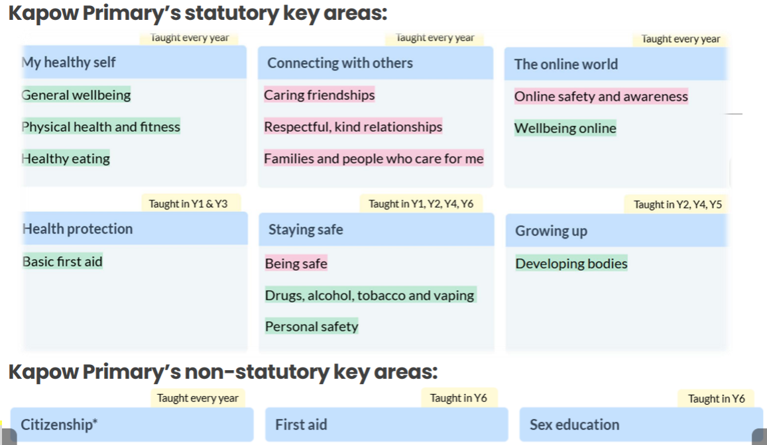
PSHE & RSE
This year we are using a new scheme of learning to enhance our delivery of the PSHE & RSE curriculum.
This is a spiral curriculum where topics are revisited throughout the child’s time at Primary school, in order to build on their prior learning.

Slide 16
Weekly Timetable:
Daily act of worship
P.E: twice a week
2EM: Monday and Tuesday
2RK: Monday and Friday
Spelling quiz on Monday
Library visit

Slide 17

Educational Visits:
We enhance and enrich the curriculum through a variety of activities: educational trips and visitors, school performances, as well as extra-curricular lunchtime and after school clubs.
Trips and Visits – Dates TBC
Autumn – Visit from local firefighter
Spring – Beaulieu Motor Museum

Slide 18

Feedback:
Focus on verbal feedback
Dialogue with your child, focusing on their next steps
Use of feedback code in books

Slide 19


Home learning
Weekly expectation: 1 x maths task / daily reading / spellings
Maths task:
Accessed via Microsoft Teams
Consolidates learning covered in class
Set on a Friday and due in by 7pm the following Wednesday

Slide 20



Reading - children are asked to read a wide variety of genres at least 4 times a week at home. Please sign their planner each week to acknowledge this.
Weekly spellings – focus on spelling patterns and common exception words. Words will be accessible to practise on Spelling Shed.
Times tables – we will focus on x2, x5, x10 over the course of the year.

Slide 21
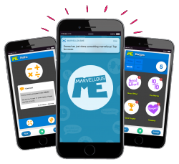

Marvellous Me:
We will continue to use Marvellous Me to share updates on your child’s learning and celebrate their success.

Slide 22
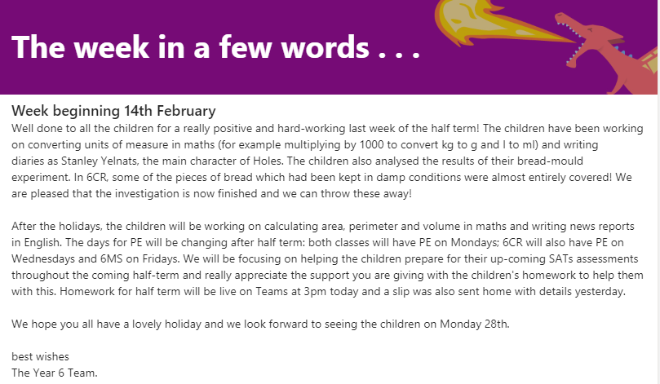
A week in a few words:
We will continue to post a weekly summary of your child’s learning on Microsoft TEAMS. We will also endeavour to inform you of what we will be covering during the following week.

Slide 23

How can you help the school?
S&PA
Volunteer readers

Slide 24

Any questions? …
Thank you for listening.

