Slide 1


Year 1

Slide 2
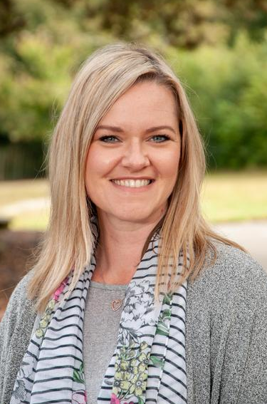
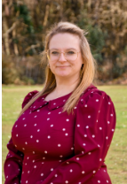
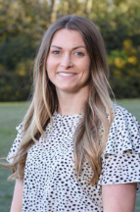
The Year 1 Team:
Class teachers:
1 LT
1N/B
Mrs Toms
Miss Neal and Mrs Badminton
Mon-Th Tu PM and Fri

Slide 3
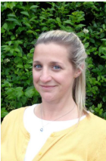
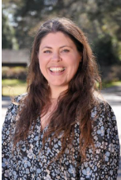
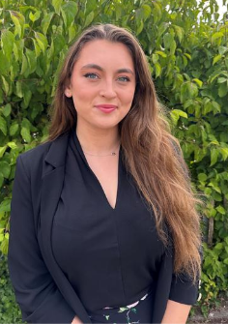
The Year 1 Team:
Teaching Assistants:
Mrs Ferri
Miss Butchers
Miss Giles

Slide 4


Vision and Values:

Slide 5

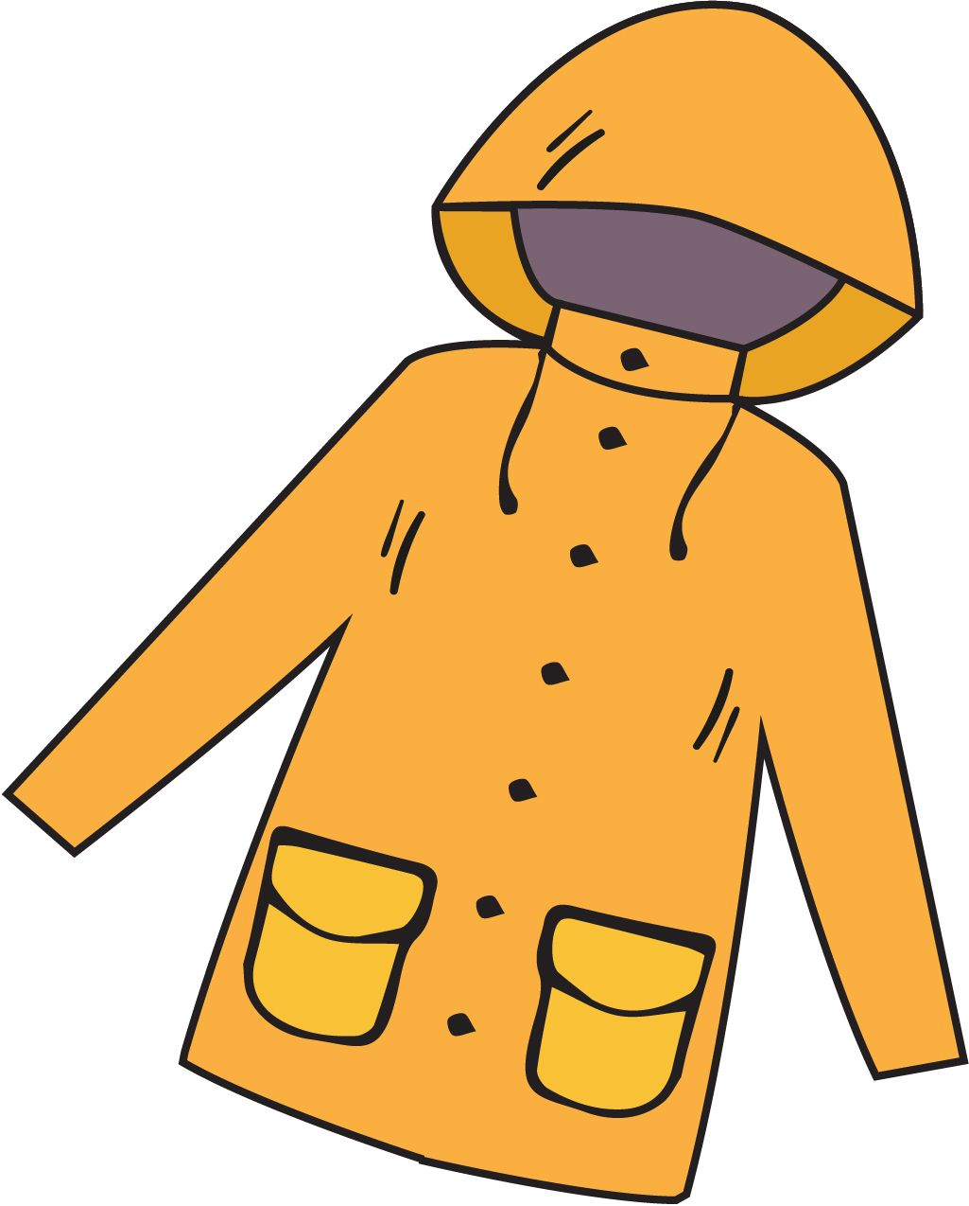

What does my child need to bring?
All stationery your child requires will be provided by the school
School planner
School reading book (reading folder)
Library book only on specific day
Water bottle
Morning snack (fruit/veg)
Waterproof coat
Trainers (for break / lunchtime football)
*Please ensure all items are named – thank you!

Slide 6
School uniform:
Yellow polo shirt with school logo and grey V-neck jumper or cardigan
Black trousers or shorts / black knee-length skirt or pinafore / yellow & white checked summer dress
Black socks (ankle or knee length) or black tights
White socks with summer dresses only please
Black formal leather or leather-look school shoes
All hair at or below shoulder length must be tied back at all times
Hair should be off the face, clipped back and not obscuring sight.
Hair ties should be in appropriate colours and styles suitable to blend with school uniform (yellow/white bands)

Slide 7
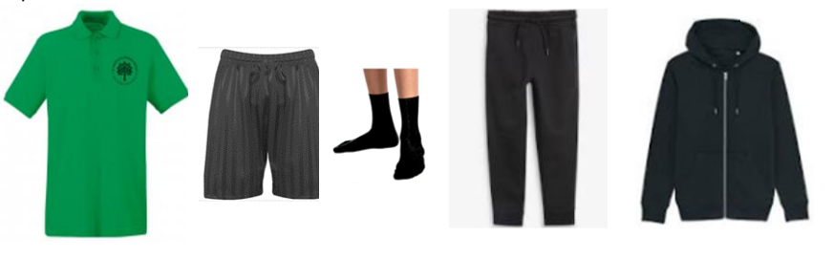

P.E Kit:
Emerald green short-sleeved polo shirt with logo
Plain black shorts
Short black socks
Plain black tracksuit for winter
Trainers only to be worn on P.E. days, but should be in school for break/lunchtime football.
Earrings must be removed & hair tied back and off the face
No gym/cycling shorts or leggings please

Slide 8

Our Curriculum Intent:
We deliver a broad and balanced curriculum to develop a life-long love of learning. Our curriculum underpins our school vision statement of ‘flourishing together’ as it is ambitious for all.
Children will journey through St Mark’s with their passion for learning ignited and with their self-belief and wellbeing nurtured.
Every child will have the opportunity to flourish and will leave us prepared for a future of possibilities. Our curriculum responds to the needs of our children and enables them to shine academically and flourish socially, emotionally, morally and culturally whilst ‘loving God’ and ‘serving others’.

Slide 9
How is the week structured?
English (including reading, writing, phonics) and Maths are taught daily
Weekly timetable includes P.E, R.E, Science, Music, French & PSHE (including Trick Box)
Geography, History, Computing, Art and Design Technology will be taught in units throughout the year
As each subject area is taught discretely, children are taught to appreciate the distinctive uniqueness of individual subjects and aspire to become future scientists, computer coders, historians, etc.

Slide 10


Curriculum:
English: We will continue to use high-quality texts as a basis to develop the children’s writing and appreciation of spelling, punctuation and grammar.
Children will be given the opportunity to write for a range of contexts, purposes and audiences. We will build up the writing process slowly over a few weeks with time to plan, draft, edit and publish their writing.
We have a school wide focus on writing including letter formation, spelling, grammar, punctuation and sentence structure. We will be practising the basics of writing this week and encourage any writing support at home too – letter formation and presentation being key skills in Year One.

Slide 11

The importance of reading:
Language is a means to communicating effectively, but it is also the doorway to magical and exciting worlds.
Through a carefully planned and language-rich curriculum, we seek to enable our learners to become confident communicators, who are equipped to succeed now and in the future.
Quality texts are at the heart of our curriculum and we seek to foster a love of reading. We recognise that fluency in reading enables children to have access to the full curriculum entitlement. We seek to develop a passion for reading for pleasure and enjoyment.

Slide 12




A selection of our Year 1 class texts:

Slide 13
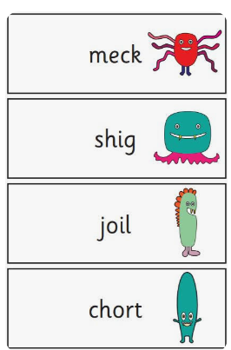
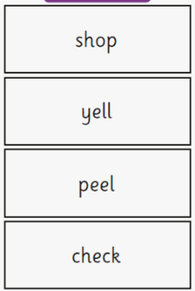
Phonics screen
Government test held in June
Children expected to reach a required standard – retaken in Year 2 if not met.
Children are given 40 words to read – 20 real words and 20 non words (shown with an alien next to them).
In previous years the children had to read 32 words to meet the required standard.
The words contain digraphs and trigraphs from all phases.

Slide 14



Curriculum:
Maths:
We will continue to use the White Rose scheme of learning to deliver high-quality mathematics lessons with a focus on developing the children’s mathematical fluency, as well as their ability to problem solve and apply their learning to different real-life contexts.

Slide 15

Curriculum:
Religious Education:
As a Church of England school, faith and belief play a key role in the life of the school and our curriculum is centred around our vision statement of ‘loving God’.
We value R.E as a core subject and encourage an enquiry-based approach to learning about Christianity and other faiths.
The children will have weekly R.E lessons, as well as daily acts of worship.

Slide 16
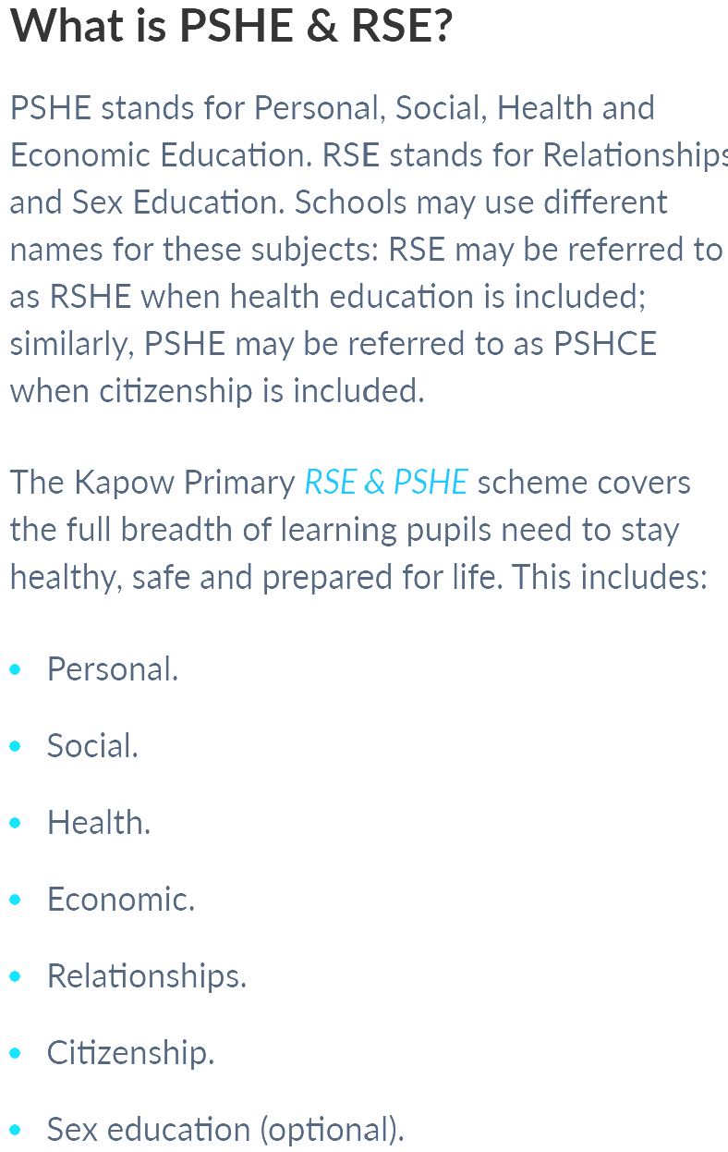

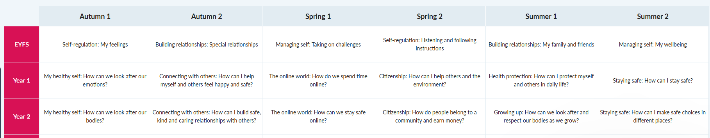
PSHE & RSE
This year we are using a new scheme of learning to enhance our delivery of the PSHE & RSE curriculum.
This is a spiral curriculum where topics are revisited throughout your child’s time at Primary school, in order to build on their prior learning.

Slide 17
Weekly Timetable:
Weekly visit to the school library – day TBC
Daily act of worship Phase worship - Friday
P.E: twice a week
1LT: Thursday and Friday
1NB: Tuesday and Friday
Swimming TBC

Slide 18
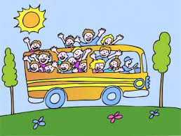
Educational Visits:
We enhance and enrich the curriculum through a variety of activities: educational trips and visitors, school performances, as well as extra-curricular lunchtime and after school clubs.
Autumn- explore our local area
Spring-trip to the Museum of East Dorset

Slide 19

Feedback:
Focus on verbal feedback
Dialogue with your child, focusing on their next steps

Slide 20


Homework
Weekly expectation:
Reading and Phonics
Children are asked to read with an adult at least 4 times a week at home. Please sign their planner each week to acknowledge this. 4x a week earns a merit!
Phonics practise – sheet sent home each week later in the Autumn term
Maths task:
Accessed via Microsoft Teams
Consolidates learning covered in class
Set on a Friday and due in by 7pm the following Wednesday

Slide 21
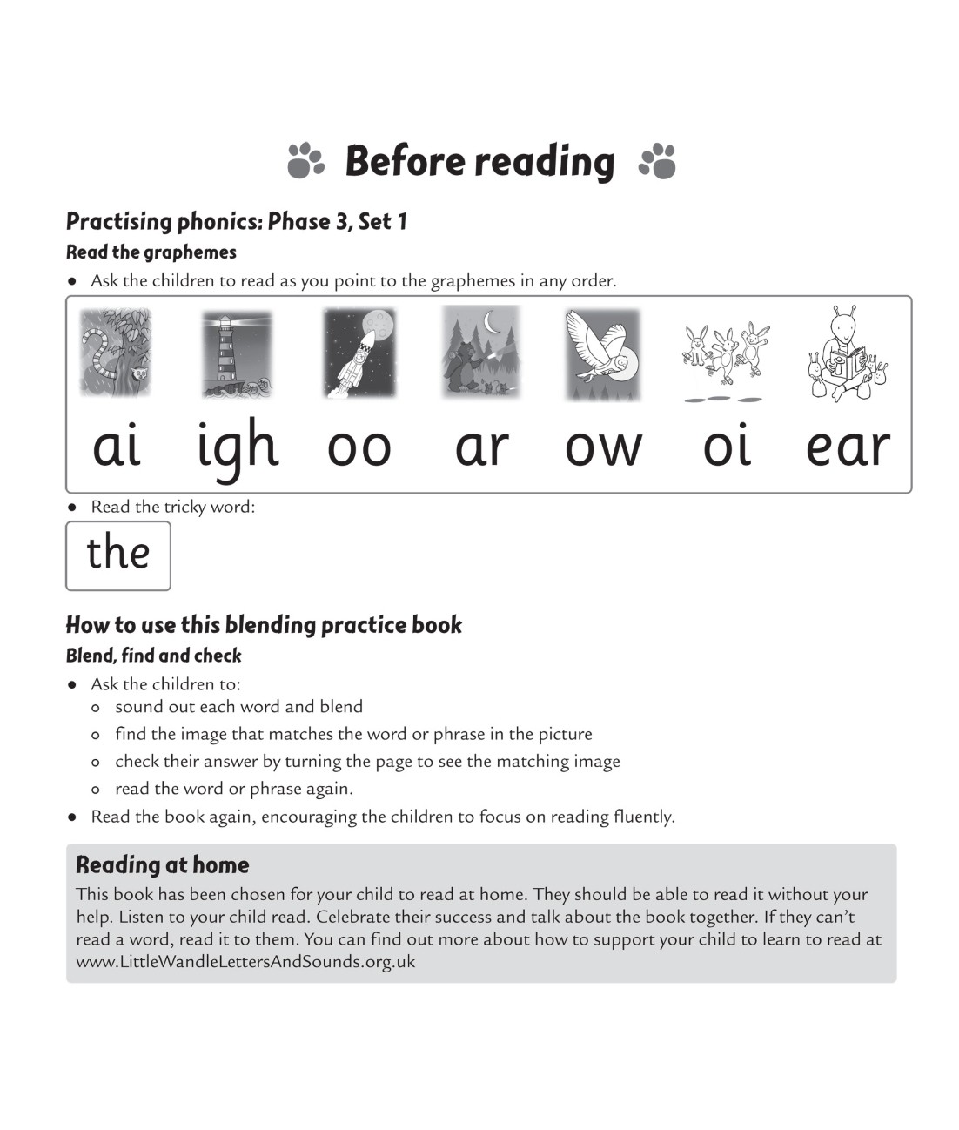


Reading at home

Slide 22
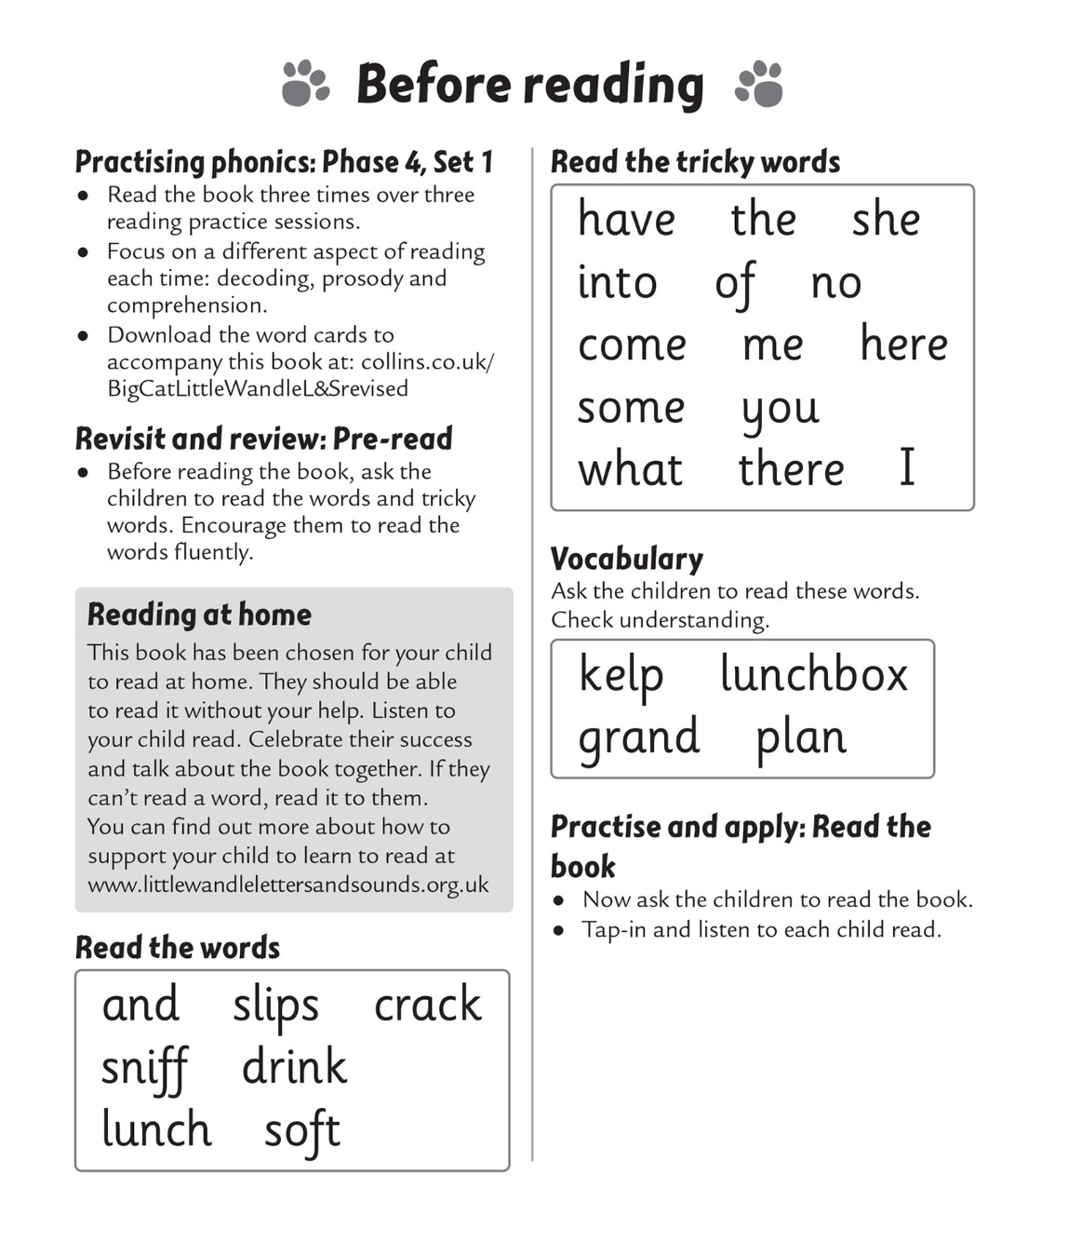
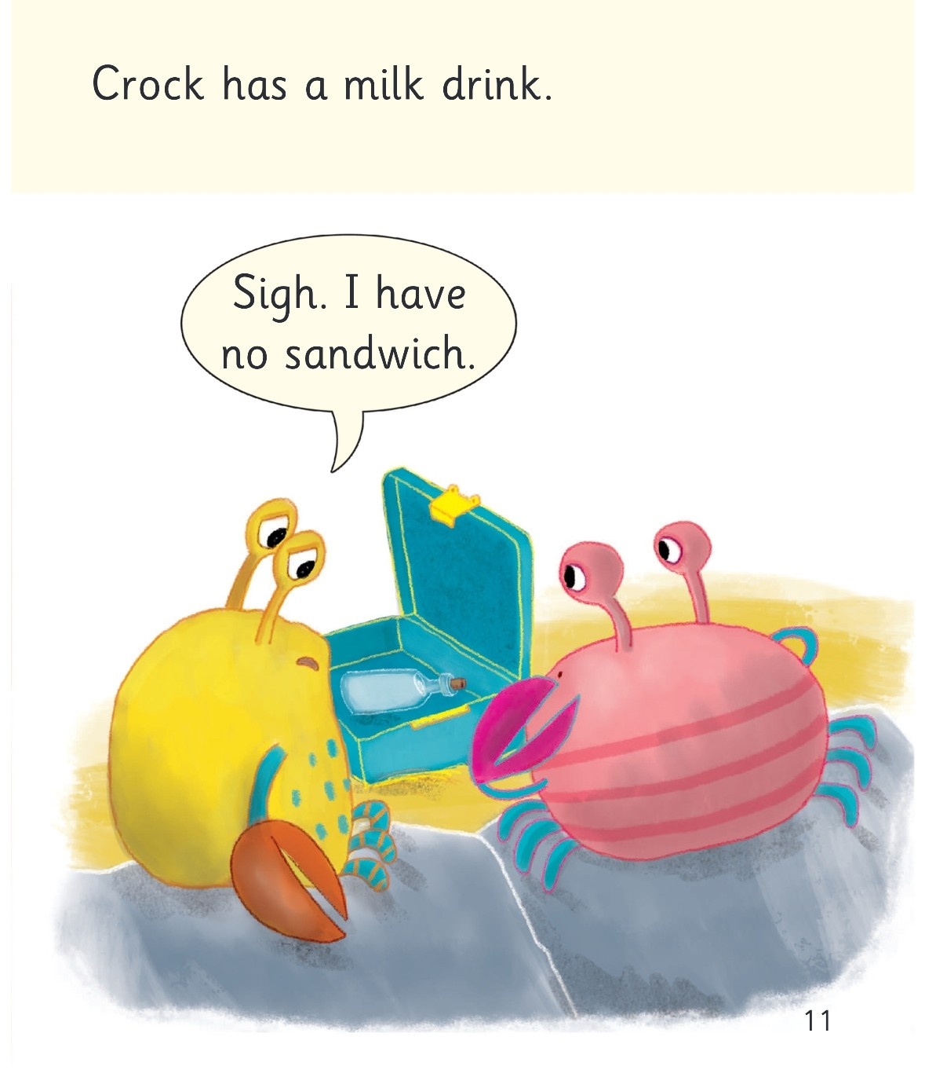
Reading at home

Slide 23
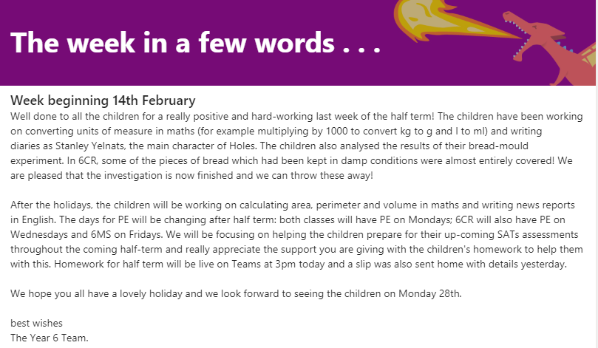
A week in a few words:
We will post a weekly summary of your child’s learning on Microsoft TEAMS. We will also endeavour to inform you of what we will be covering during the following week.

Slide 24

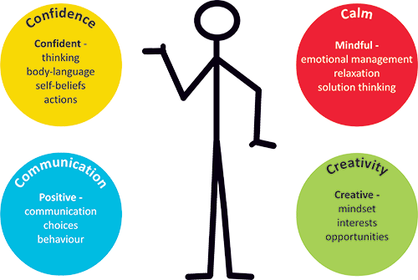

Mental health and well-being:
Trick Box:
Supports mental health and wellbeing
Taught a series of tricks to help deal with everyday situations
Promotes important skills: resilience, independence, etc.

Slide 25



Reward Systems
Continued brilliant choices means
you get to move to the shooting star!
Message sent home
Merits add up to earn certificates!
-Bronze
-Silver
-Gold
-Headteacher’s Award
Planners are checked on a Friday for
certificates- but please make sure t
they are in your bag every day.
Good choices, hard working, kind
words and actions and lots of
other amazing behaviour gets you
onto the rainbow.
1 merit
Everyone starts the day on the sun.

Slide 26


How can you help the school?
Volunteers for S&PA- raise vital funds for our children and school
Volunteers needed to listen to children read
If you are interested, please ask at the office or email parentmail

Slide 27
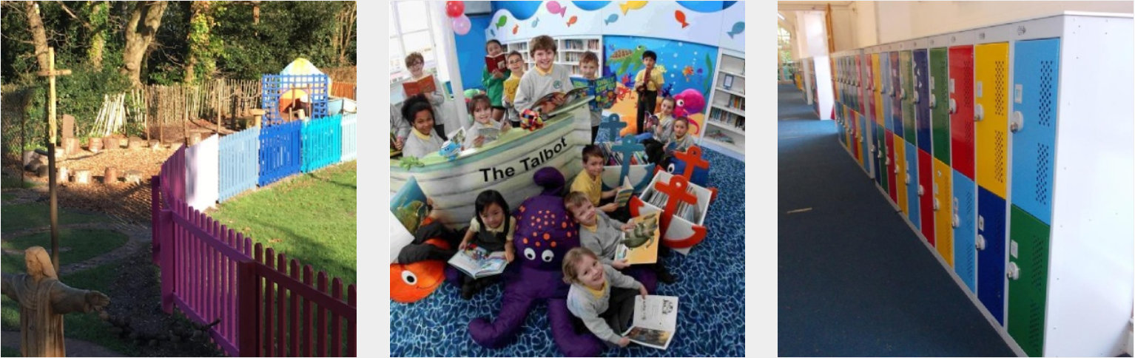
S&PA volunteers
St Mark's School and Parent Association (S&PA)
What do we do? We are a registered charity and our aim is to raise money for the school and its children by holding events throughout the school year. The main events are the Christmas and Summer Fayres, children’s discos, a sponsored event and mufti days.
Who are we? A team of volunteers run the S&PA, this is not limited to parents and carers, we welcome step-parents, grandparents, aunties and uncles! We have a lot of help from Mr Bright, Mr Coombes, the office staff and the teachers.
What do we raise? On average £10,000 a year, which is donated to the school at the Annual General Meeting in October. The AGM is open to all, not just those who attend meetings throughout the year!
What does the money go towards? Past funds raised have paid for the very smart school minibus, all the lockers around the school, the refurbished library and the Garden of Peace. We are currently raising money for the school swimming pool. If you have any suggestions for next year's money, please let us know!
How do I join? All parents of the school are automatic members of the S&PA, but we always need more helpers; we are very short on these, so please don't assume everyone else has it covered! If you want to be on the mailing list so that you are able to see what jobs need doing, please just give us an email on the address below.
When do we meet? Approximately once a month usually on a Monday evening via zoom to chat and organise forthcoming events (see calendar - S&PA events are tagged in purple). Meetings are very informal and don’t take longer than an hour.
Thank you for taking the time to read this, we hope your children thoroughly enjoy being part of St Mark’s School.
stmarkssandpa@hotmail.co.uk
Facebook page: St Marks SPA https://www.pta-events.co.uk/stmarkssandpa

Slide 28

Any questions? …
Thank you for listening.

